Slide 1
Flashing for Wood and Fiber-Cement Siding

Slide 2
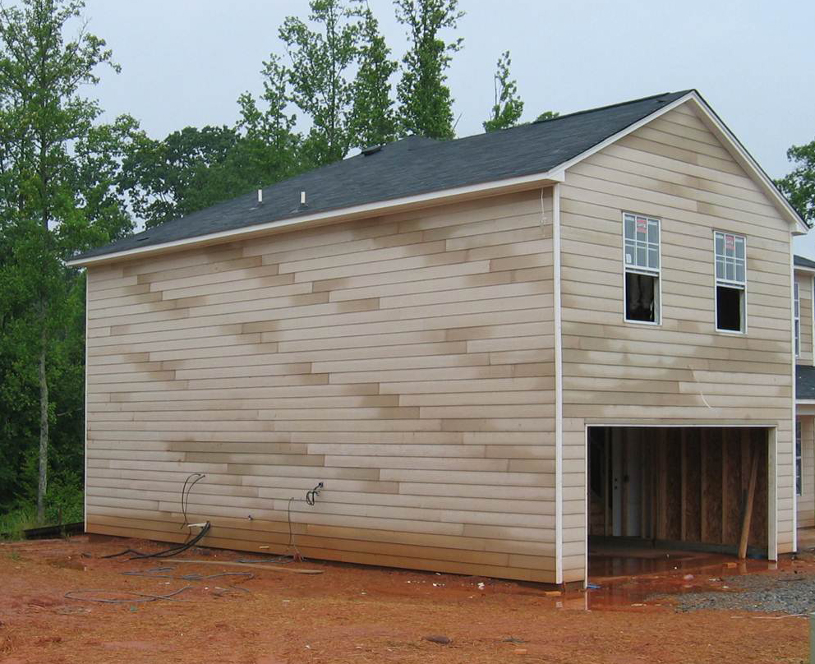
Notes:
All cladding systems leak. It's not a matter of if, it's a matter of when. It's important to understand that proper moisture management dictates that when water gets through penetrations, we want this water to drain down the wall freely, and exit the wall at the base of the siding. That's why the detailing and integration of flashings are so critical to building long-lasting, durable buildings.

Slide 3
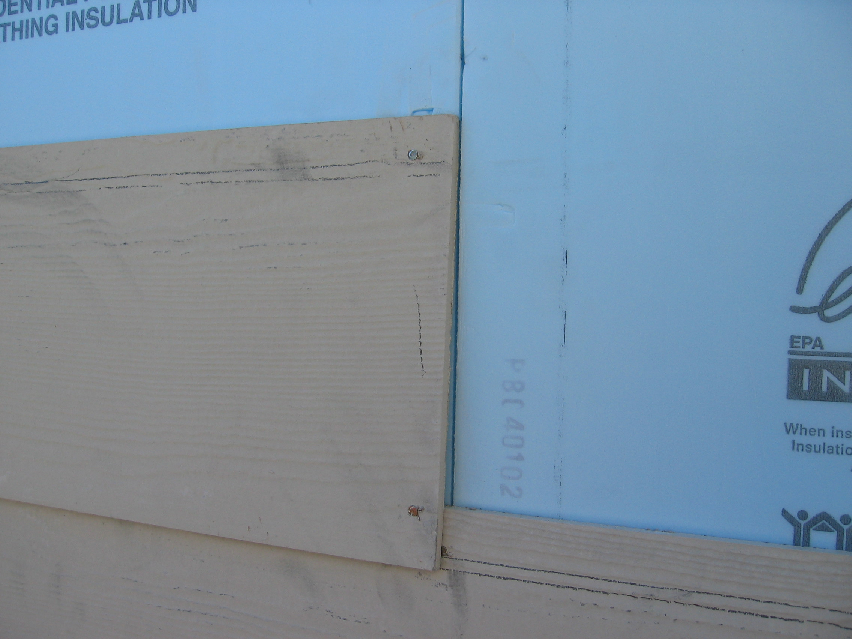
Notes:
In this photograph we can see that this home has cement-board siding over foam board sheathing. Even though foam board sheathing is not affected by moisture, codes still require that we have a weather-resistive barrier (WRB). As you can see here, the butt-joint of this siding lines up perfectly with the seam in the foam. So in a wind-driven rain, it would be very easy for water to penetrate this seam, get in between the foam into the wall cavity where it can cause lots of damage. It's critical to have a properly shingled WRB that directs the water downward, where it can exit freely.

Slide 4
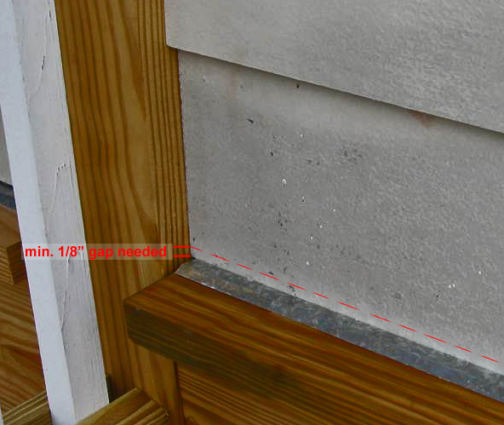
Notes:
This photograph shows an example of improper drainage at the base of the wall in conjunction with cement-board siding. The moisture build-up in the siding shows that the wall is not getting free drainage. One of the problems here is there is not enough space between at the bottom of the siding and that through-wall flashing. There should be at least 1/8 inch gap to prevent capillary action. And it's important that the flashing be properly integrated behind the weather-resistive barrier for proper shingling of water away from the house.

Slide 5
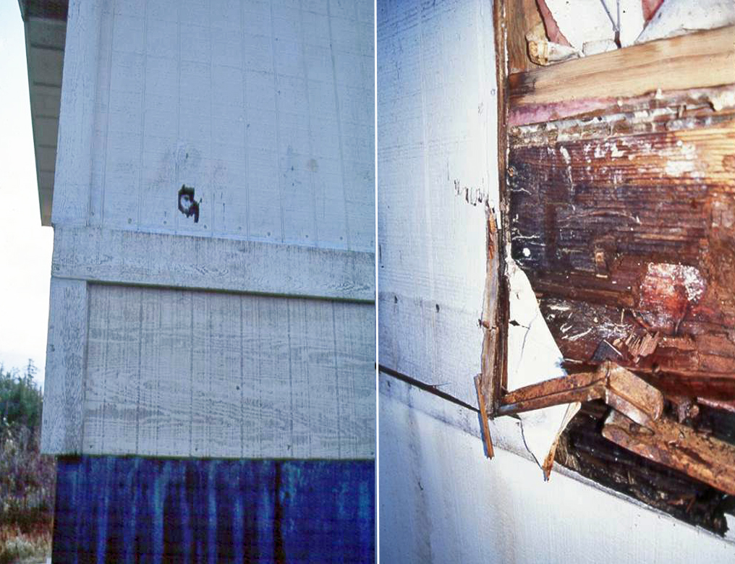
Notes:
In the photograph on the left, we can we that we have T-111 siding. These T-111 siding panels may not be long enough to side the entire structure without a seam. So here for example, we have two pieces of T-111 siding covered by a trim board. In the photo on the right, we can see there is a substantial amount of damage due to water leaks at the seam where these two pieces of T-111 plywood meet. You can also see that there was a thin piece of metal Z-flashing, but it was not adequately sized, nor properly integrated with the weather-resistive barrier to provide free drainage to the base of the wall.

Slide 6
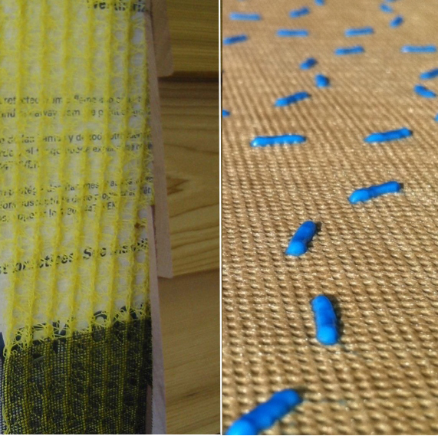
Notes:
It's fairly typical for wood or cement-board siding to be installed tightly up against the building wrap, and this can restrict drainage. So manufacturers have created rain-screen materials and drainage wraps. The photo on the left shows a rain-screen product. This is a plastic matrix that is about 1/4-inch thick that facilitates drainage, and provide an air space that helps prevent capillary action, so water can drain down the wall system and exit at the base of the siding. The product on the right is a drainage wrap material. These are different than an standard building wrap in that they have a texture, or in this case, plastic deposited on the surface to create a space for drainage. It doesn't take much or an air space to create better drainage.

