Slide 1
Water-Managed Vinyl Siding
Prepared for DOE’s Building America Program
Steve Easley & Associates, LLC
June 2023
www.steveeasley.com

Slide 2
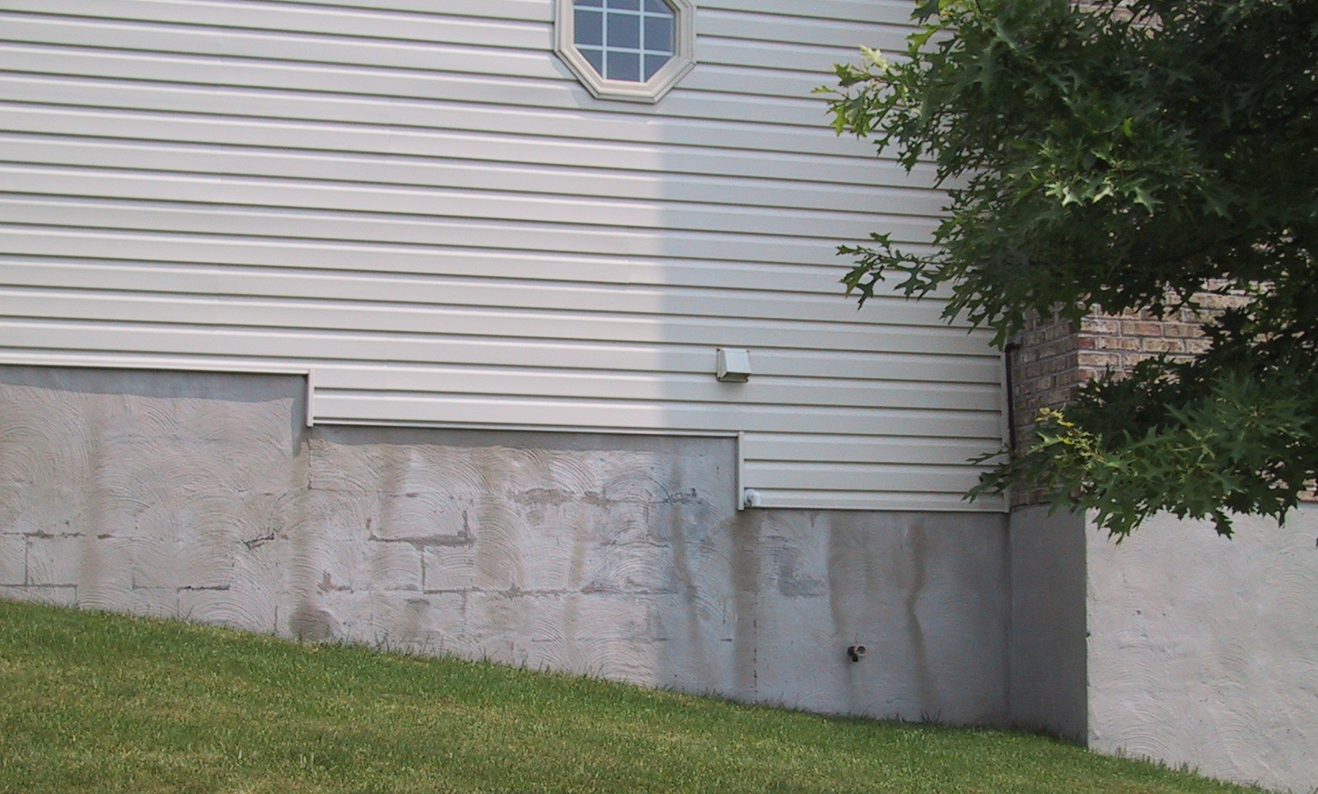
Photo Courtesy of Steve Easley & Associates, LLC
Because vinyl siding has an air space behind it, it acts like a rain screen. As you can see from this photograph, the water tracks down the foundation wall indicate how freely this siding can drain. Vinyl siding comes with pre-punched weep holes to allow for drainage. You do need to use a weather-resistive barrier behind the vinyl siding. Also, you would need to use flashing at the base of the wall if that siding transitions to a trim board or to another type of cladding.
Notes:
Because vinyl siding has an air space behind it, it acts like a rain screen. As you can see from this photograph, the water tracks down the foundation wall indicate how freely this siding can drain. Vinyl siding comes with pre-punched weep holes to allow for drainage. You do need to use a weather-resistive barrier behind the vinyl siding. Also, you would need to use flashing at the base of the wall if that siding transitions to a trim board or to another type of cladding.

Slide 3
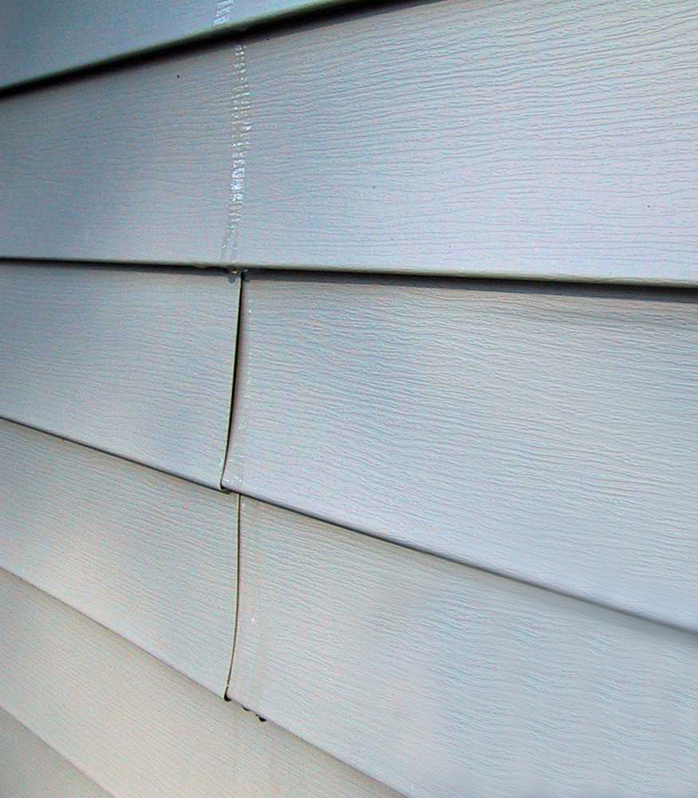
At first glance, vinyl siding may not appear to be a very water-tight cladding system.
But, if used with a weather-resistive barrier, it can be quite effective.
The beauty of vinyl siding is that it hangs loosely on the wall and creates a fairly good air space between the vinyl and the weather-resistive barrier, allowing water to drain freely from the wall system.
Photo Courtesy of Steve Easley & Associates, LLC
Notes:
At first glance, vinyl siding may not appear to be a very water-tight cladding system. But, if used with a weather-resistive barrier, it can be quite effective. The beauty of vinyl siding is that it hangs loosely on the wall and creates a fairly good air space between the vinyl and the weather-resistive barrier, allowing water to drain freely from the wall system.

Slide 4
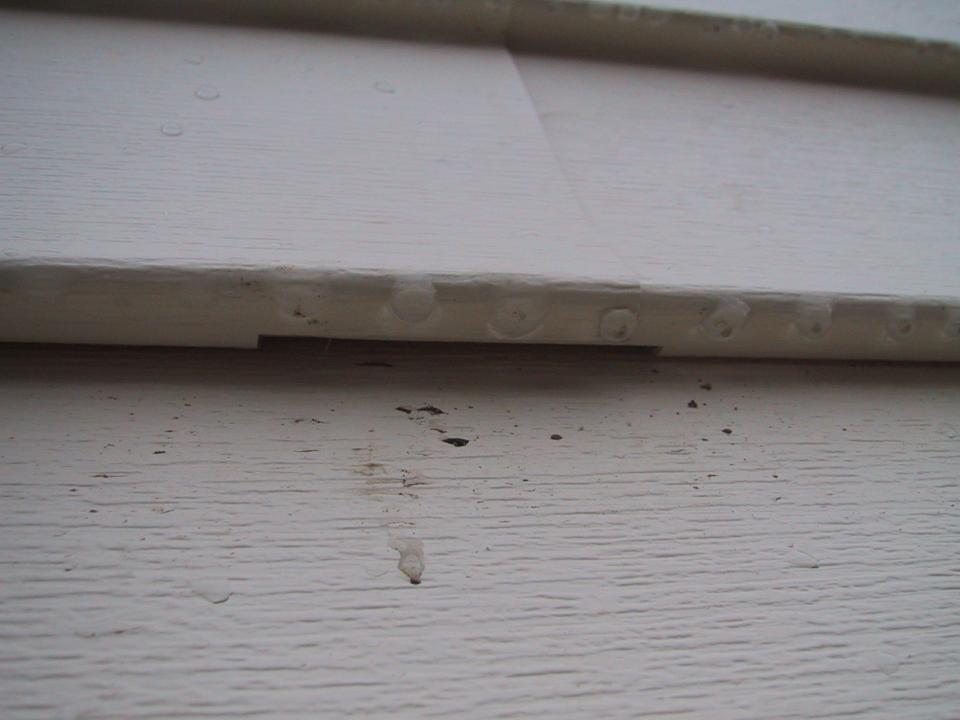
Photo Courtesy of Steve Easley & Associates, LLC
Weep holes are at every course of siding. As you can see here, water can freely flow out of the weep holes rather than being trapped inside the wall system.
Notes:
Weep holes are at every course of siding. As you can see here, water can freely flow out of the weep holes rather than being trapped inside the wall system.

Slide 5
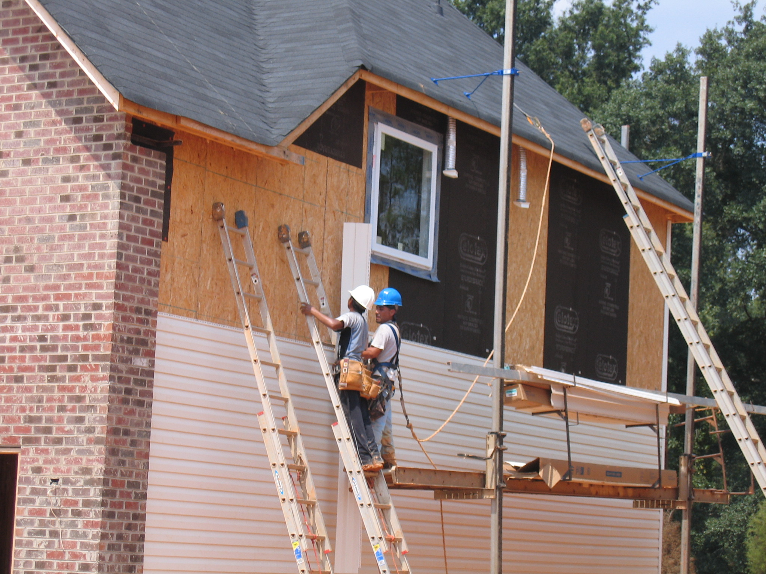
Photo Courtesy of Steve Easley & Associates, LLC
Can you spot what's wrong with this picture? The workers are installing vinyl siding but there is no weather-resistive barrier behind it. Building codes now require that there be a weather-resistive barrier behind all exterior claddings.
Notes:
Can you spot what's wrong with this picture? The workers are installing vinyl siding but there is no weather-resistive barrier behind it. Building codes now require that there be a weather-resistive barrier behind all exterior claddings.

