Slide 1
Insulating and Air Sealing
Floors above Garages
Prepared for DOE’s Building America Program
Steve Easley & Associates, LLC
June 2023
www.steveeasley.com
Notes:
All photos courtesy Steve Easley & Associates

Slide 2
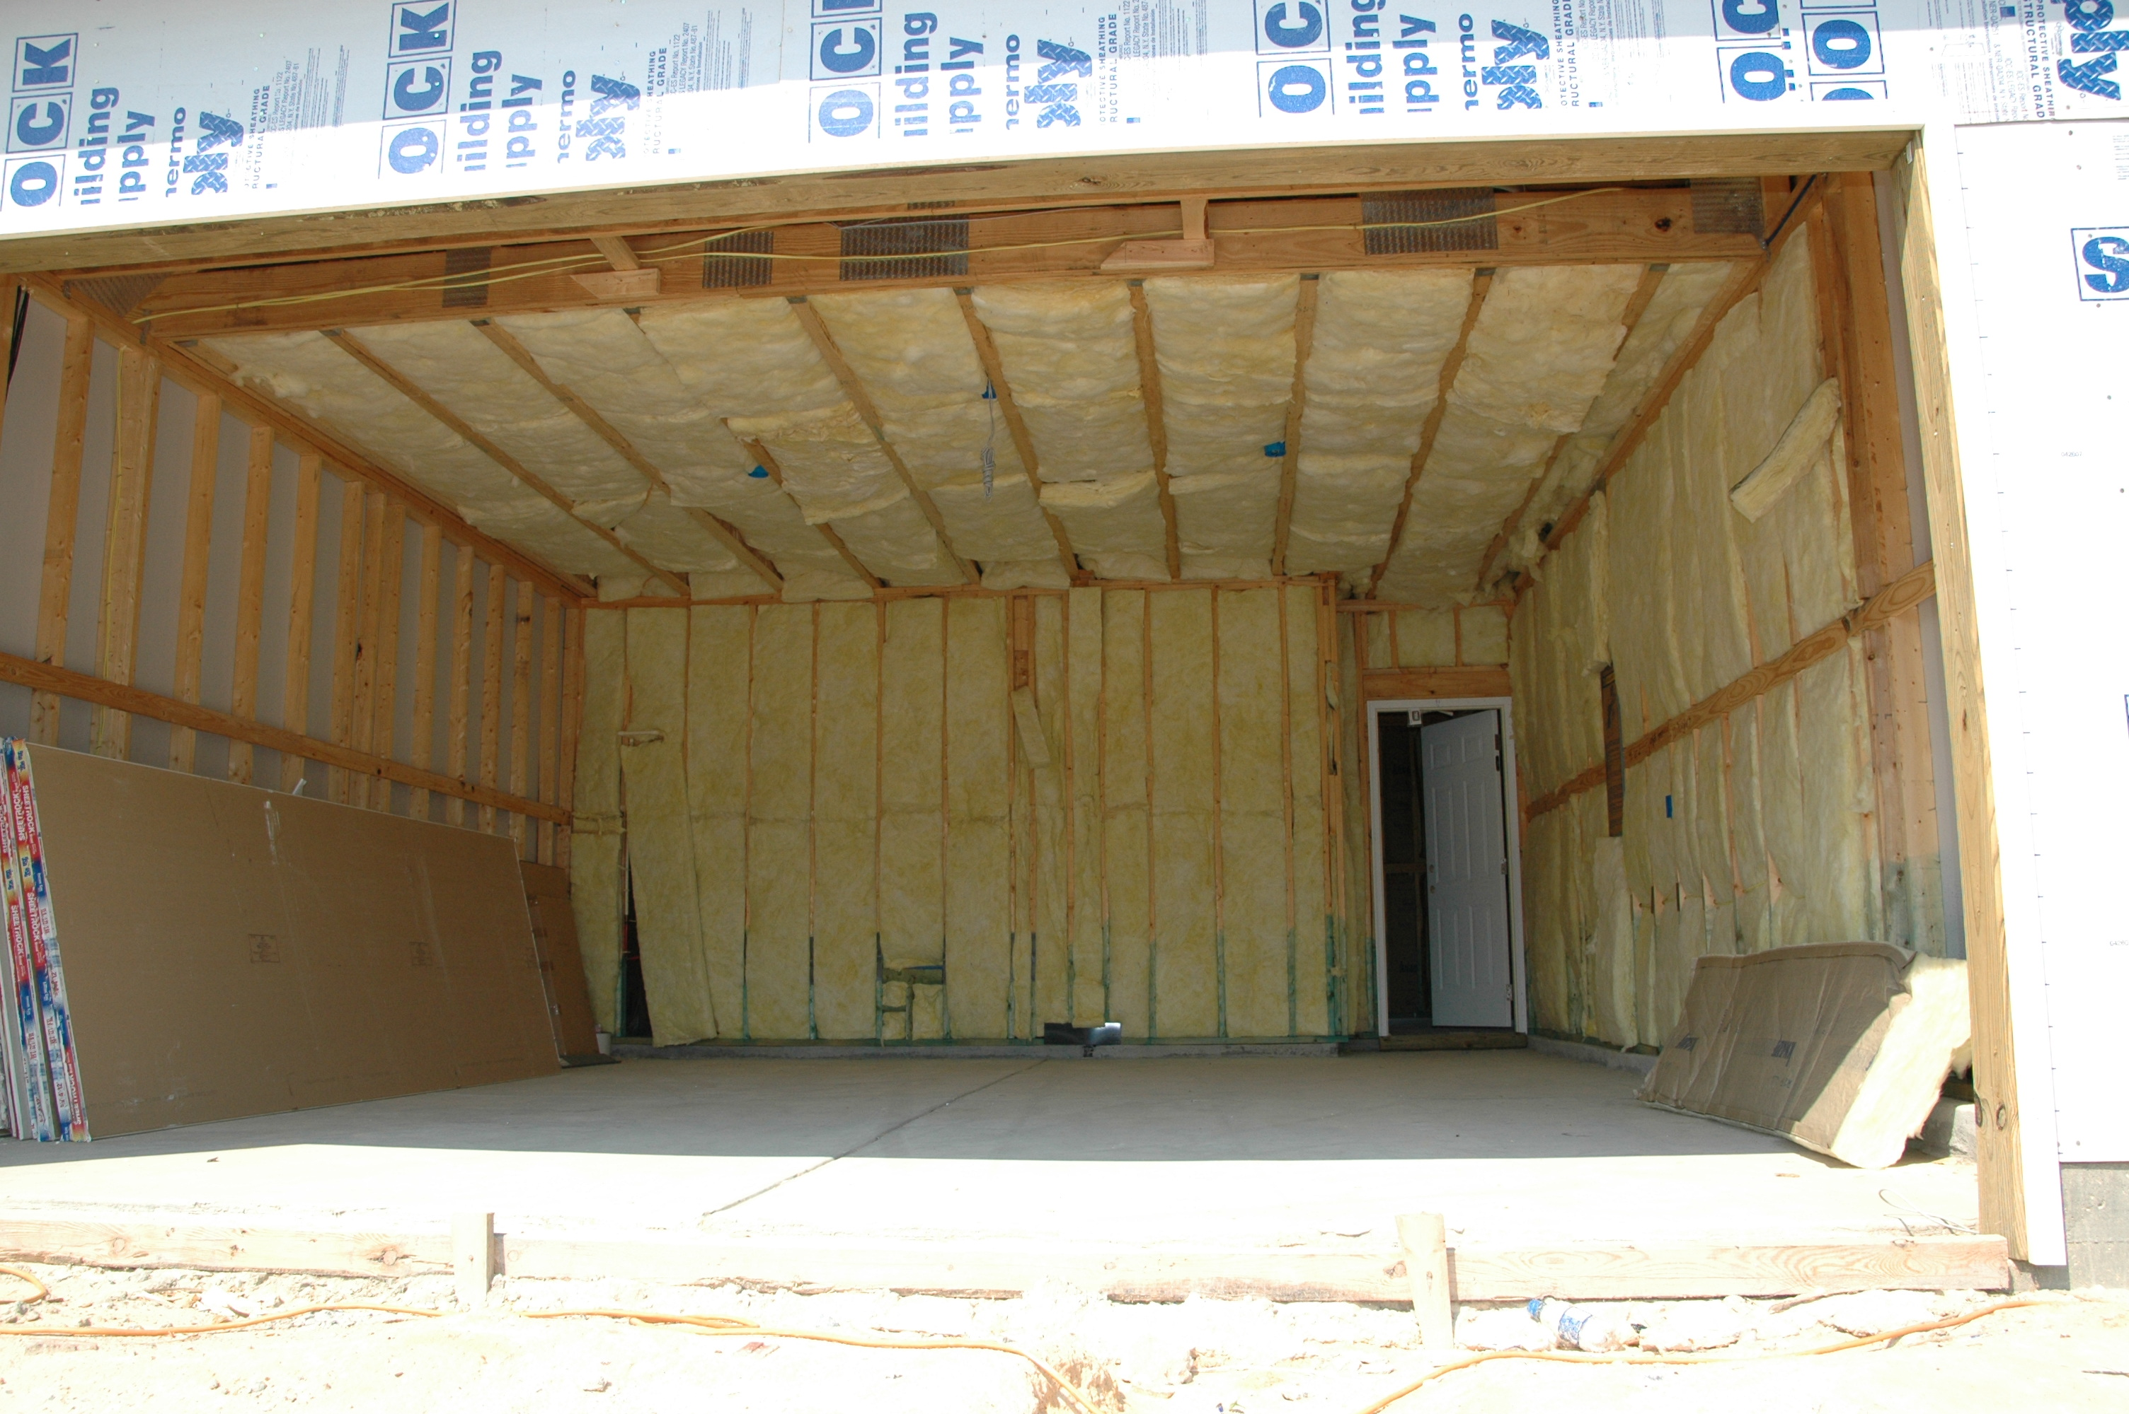
Photo Courtesy of Steve Easley & Associates, LLC
It is a fairly common design practice to incorporate living areas over garages. However, this can also create some problems in terms of making sure the home is as energy efficient as it could be. If you look at this picture, it looks like this garage ceiling is well insulated. But, unless you know the depth of those floor trusses, you really don’t know. Often what happens is that the insulation is in contact with the drywall on the garage ceiling, but not with the subfloor above. This can lead to some serious short circuits of the insulation.
Notes:
It is a fairly common design practice to incorporate living areas over garages. However, this can also create some problems in terms of making sure the home is as energy efficient as it could be. If you look at this picture, it looks like this garage ceiling is well insulated. But, unless you know the depth of those floor trusses, you really don’t know. Often what happens is that the insulation is in contact with the drywall on the garage ceiling, but not with the subfloor above. This can lead to some serious short circuits of the insulation.

Slide 3
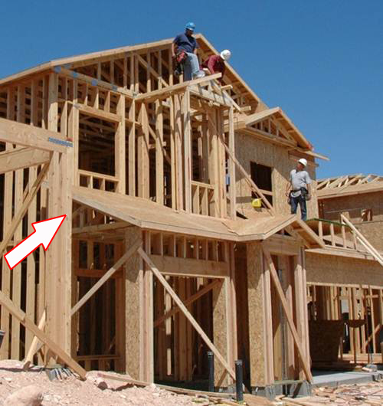
Photo Courtesy of Steve Easley & Associates, LLC
It is important to recognize that we need to have a good air barrier system where floors over garages intersect with exterior walls. In this photo, we can see that we have a shed roof coming down to the garage area. However, we can also see that under that shed roof there is no air barrier at the vertical wall plane between the house and the porch attic. An air barrier will have to be installed to prevent air from infiltrating the floor system area under the living space over the garage.
Notes:
It is important to recognize that we need to have a good air barrier system where floors over garages intersect with exterior walls. In this photo, we can see that we have a shed roof coming down to the garage area. However, we can also see that under that shed roof there is no air barrier. An air barrier will have to be installed to prevent air from infiltrating the floor system area under the living space over the garage.

Slide 4
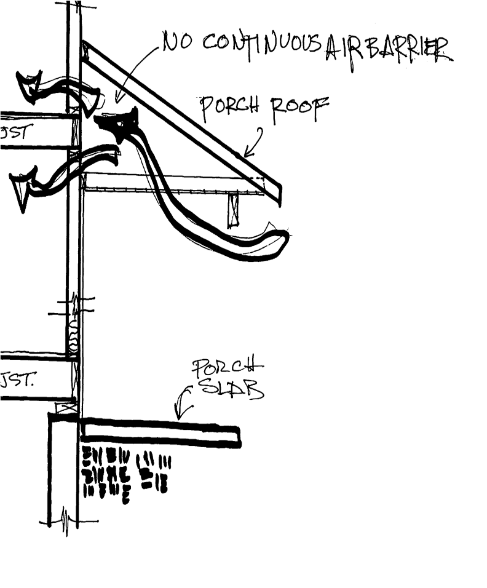
Code requires that a continuous air barrier be installed to separate the porch attic from the conditioned living space.
This drawing shows how air can flow up through the porch ceiling into the home when there is no continuous air barrier to prevent it.
Photo Courtesy of Steve Easley & Associates, LLC
Notes:
Code require a continuous air barrier be installed to separate the porch attic from the conditioned living space.

Slide 5
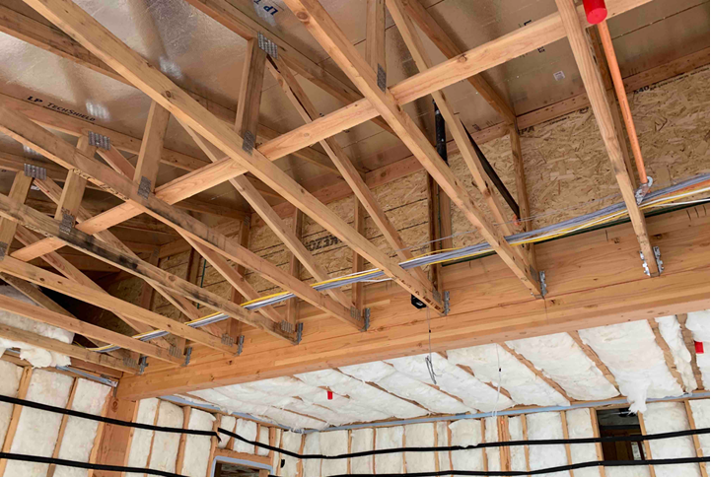
Photo Courtesy of Steve Easley & Associates, LLC
In this example, the wood sheathing was installed along the knee wall to provide a solid air barrier around the living space above the garage ceiling on the right before the trusses on the left were installed.
Notes:
In this example, the wood sheathing was installed along the knee wall to provide a solid air barrier around the living space above the garage ceiling on the right before the trusses on the left were installed.

Slide 6
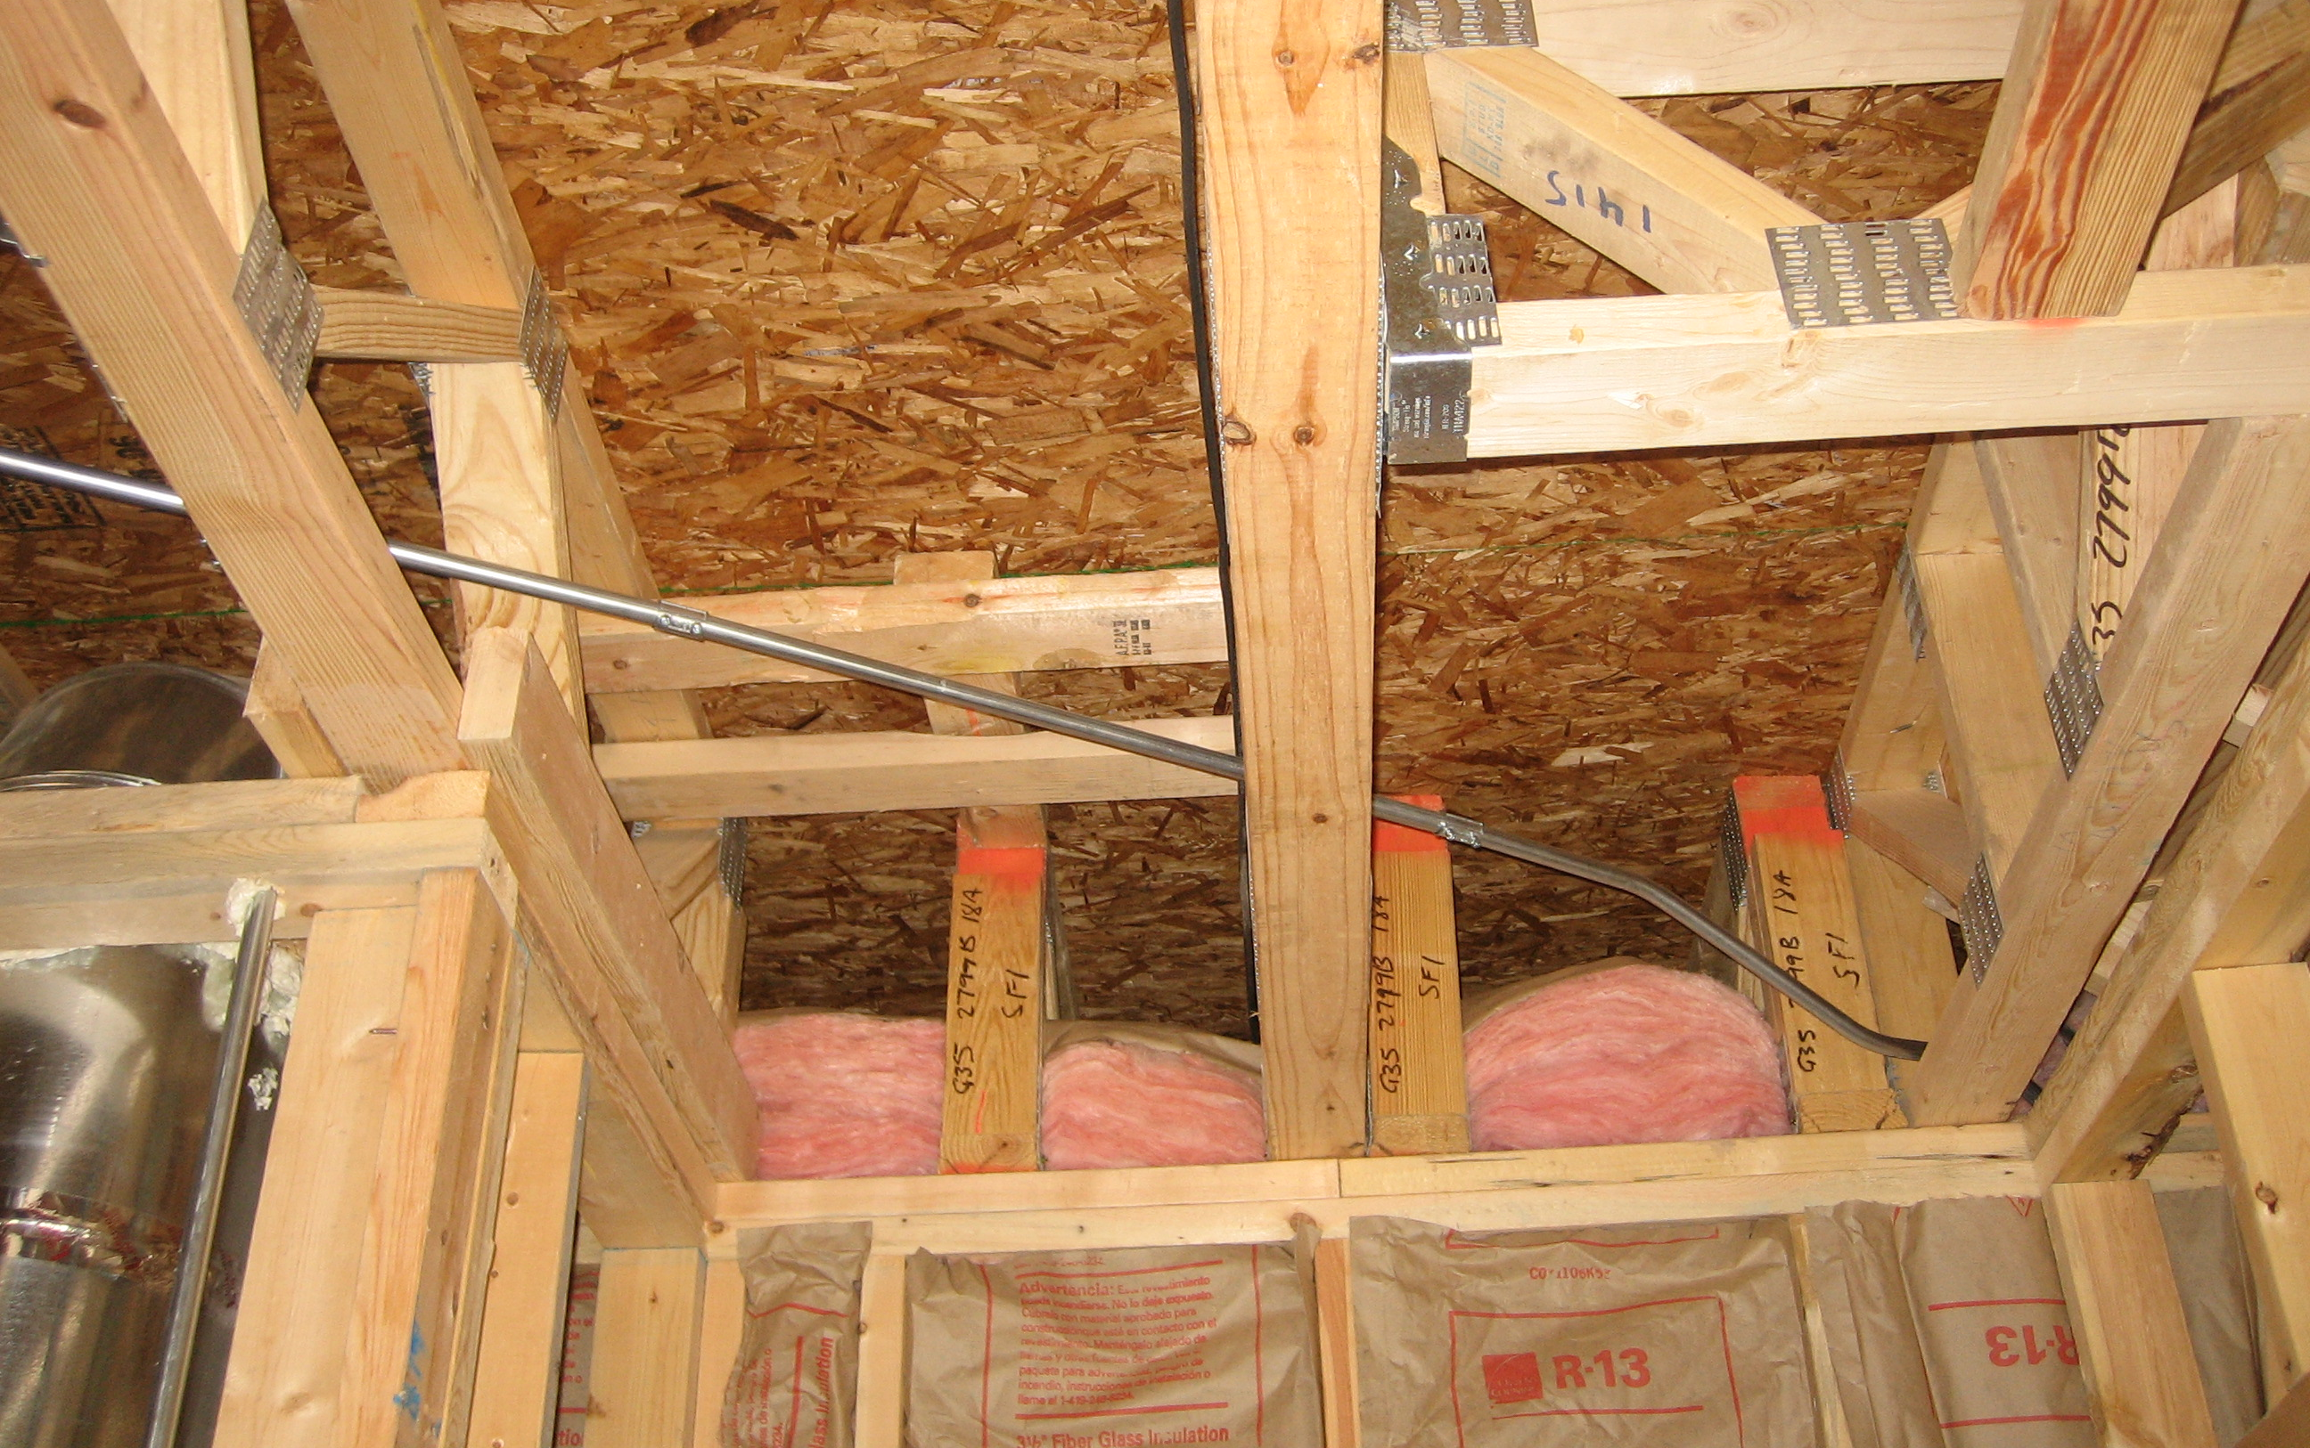
Photo Courtesy of Steve Easley & Associates, LLC
This picture is a good example of a poor insulation job of a ceiling of a garage and the floor of living space over the garage. You can see that there is a large space between the top of the insulation and the bottom of the floor. This is problematic because as air infiltrates in through the framing members, it blows across the top of the insulation, scavenges away heat (which we call wind washing) and basically eliminates the effectiveness of the insulation. That insulation needs to be in contact with the bottom of the subfloor.
Notes:
This picture is a good example of a poor insulation job of a ceiling of a garage and the floor of living space over the garage. You can see that there is a large space between the top of the insulation and the bottom of the floor. This is problematic because as air infiltrates in through the framing members, it blows across the top of the insulation, scavenges away heat (which we call wind washing) and basically eliminates the effectiveness of the insulation. That insulation needs to be in contact with the bottom of the subfloor.

Slide 7
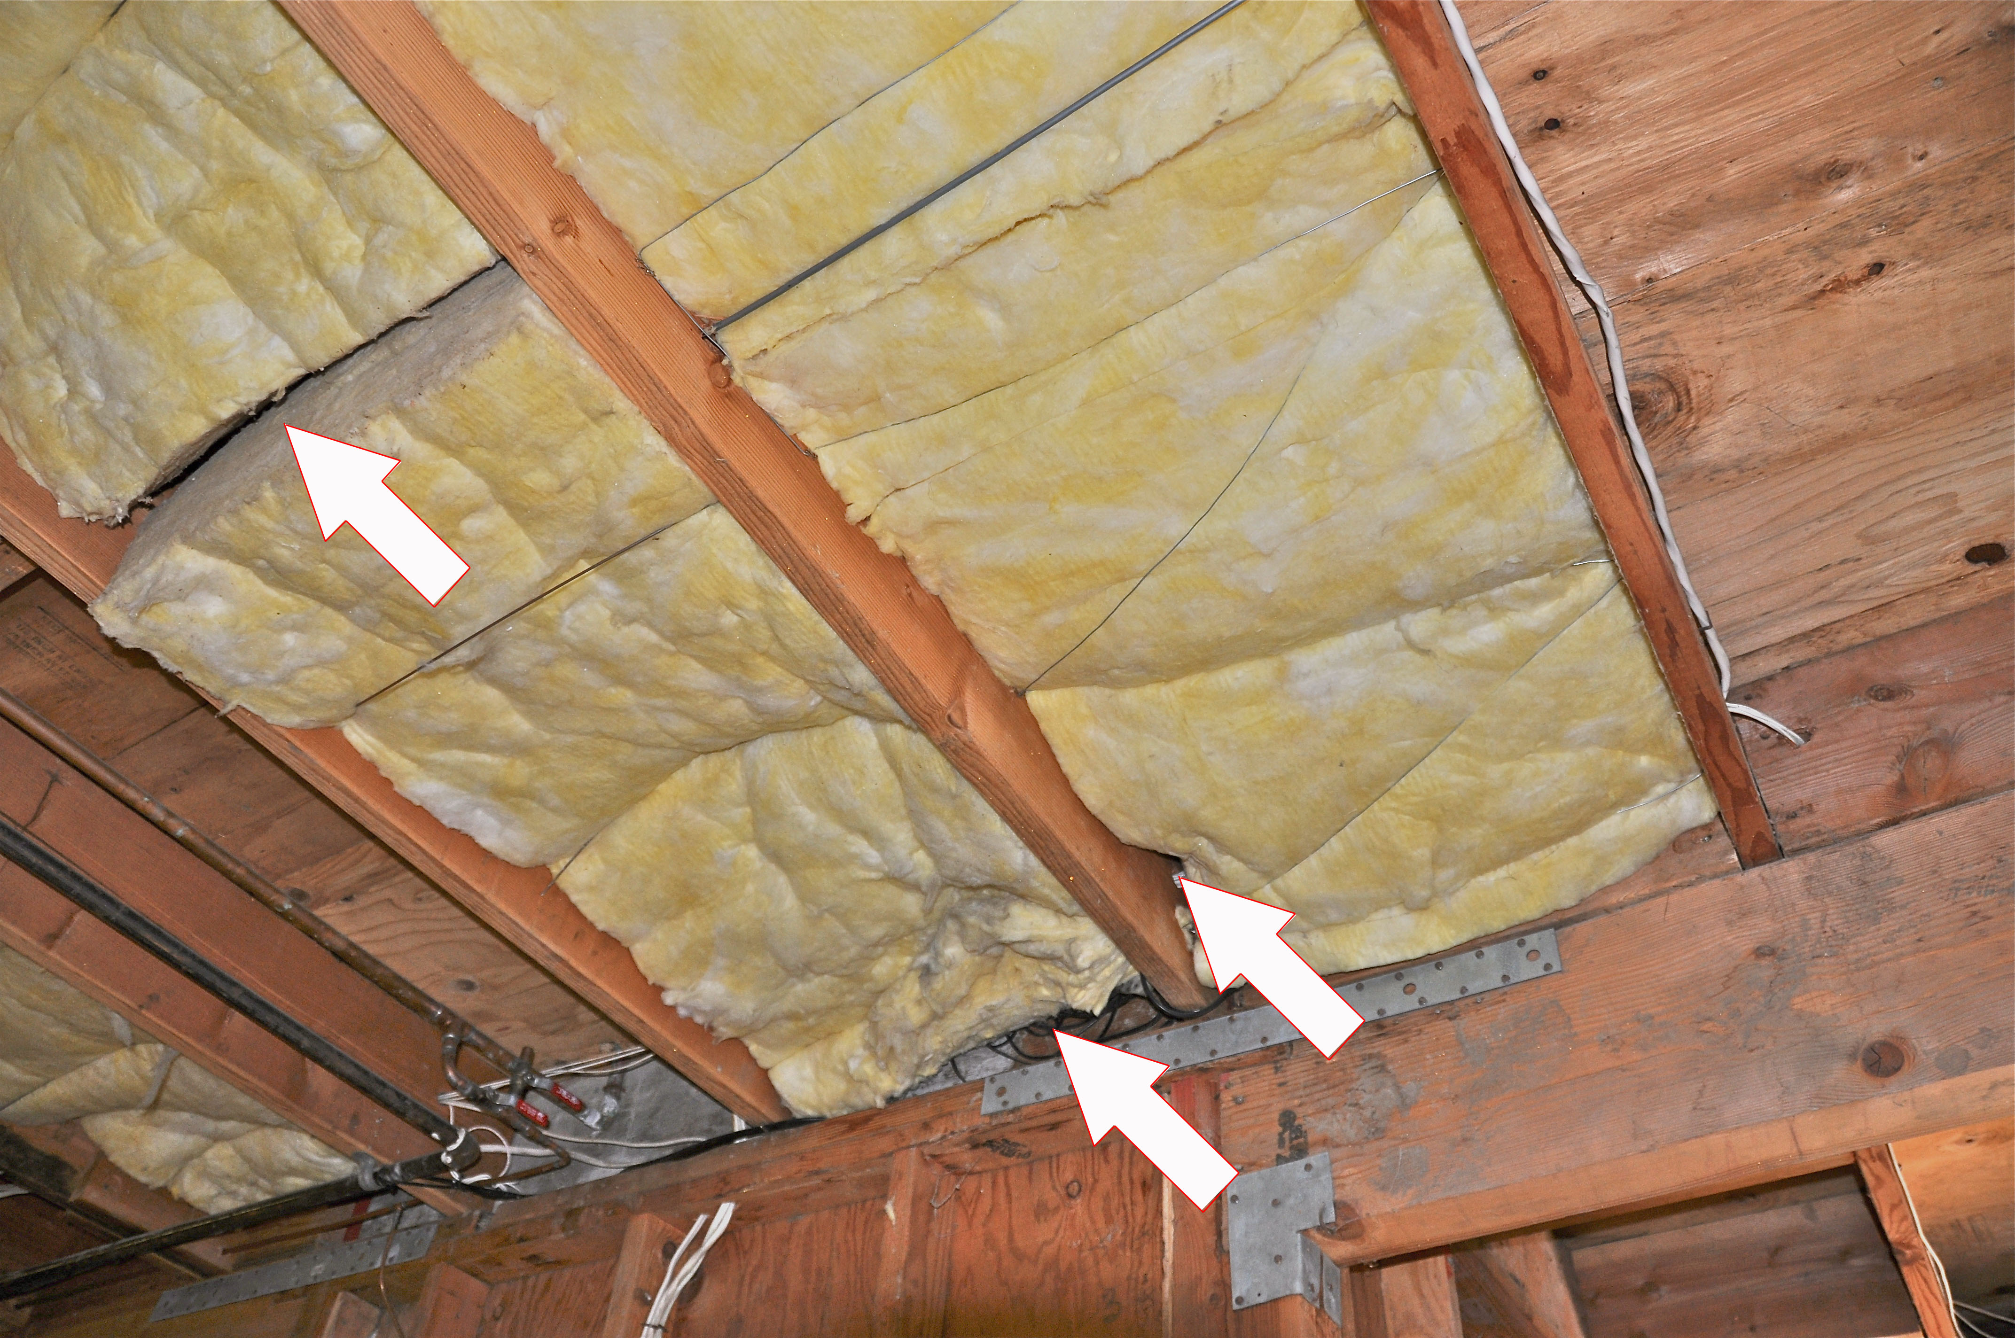
Photo Courtesy of Steve Easley & Associates, LLC
Notes:
This insulation appears to be adequately supported, but there are some significant problems with the gaps in the insulation, particularly where the batts meet the band joist and where the batts butt up against each other in the middle of the floor. Lots of heat can escape from those gaps. So, this insulation is not in full alignment with the air barrier, which is the bottom of the subfloor.

Slide 8
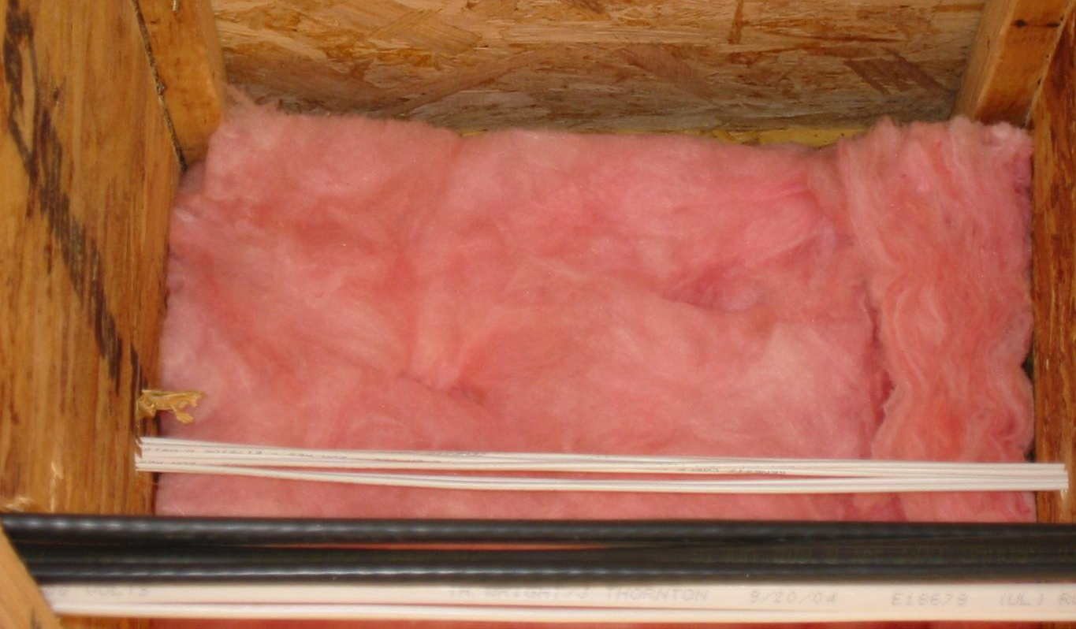
Photo Courtesy of Steve Easley & Associates, LLC
If you look carefully, you can see that there is a small gap between the bottom of the subfloor and the top of the insulation. I-joists have an irregular shape to them, and where the insulation meets the flange creates a natural gap. This gap allows air to flow across, diminishing the effectiveness of the insulation. Ideally, batts should be notched lengthwise to accommodate the flange. At the very least, the batt should be held up with wire insulation supports so the batt presses against the bottom of the subfloors. Some compression may occur at the corners of the batt, but this is far better than leaving a gap.
Notes:
If you look carefully, you can see that there is a small gap between the bottom of the subfloor and the top of the insulation. I-joists have an irregular shape to them, and where the insulation meets the flange creates a natural gap. This gap allows air to flow across, diminishing the effectiveness of the insulation. Ideally, batts should be notched lengthwise to accommodate the flange. At the very least, the batt should be held up with wire insulation supports so the batt presses against the bottom of the subfloors. Some compression may occur at the corners of the batt, but this is far better than leaving a gap.

Slide 9
Photo Courtesy of Steve Easley & Associates, LLC
This IR photo shows the air leakage above the insulation due to the gap above the insulation in the floor joist cavity.
Notes:
This IR photo shows the air leakage above the insulation due to the gap above the insulation in the floor joist cavity.

Slide 10
Photo Courtesy of Steve Easley & Associates, LLC
These floor joist cavities have been properly insulated with closed-cell spray foam.
Notes:
These floor joist cavities have been properly insulated with closed-cell spray foam.

Slide 11
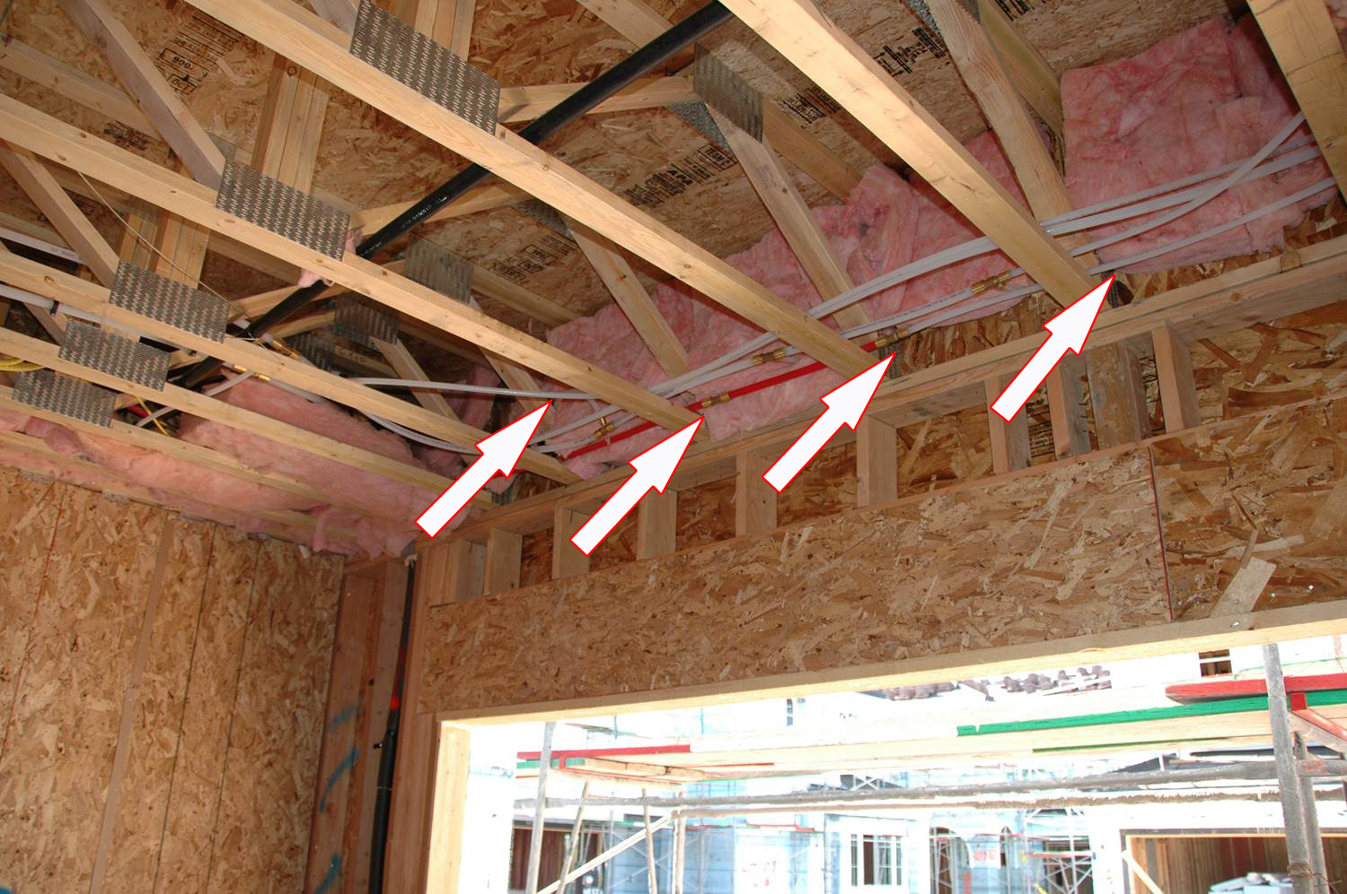
Photo Courtesy of Steve Easley & Associates, LLC
Floor trusses are common framing systems for living spaces over garages. However, they can be problematic because they make it more difficult to insulate. As you can see in this picture, where every truss is, there is a 3 1/2-inch space between the insulation. That can create some issues with the air barrier. In other words, there are places where air can easily infiltrate. It also creates issues with being able to effectively insulate this band joist area. Ideally the exterior wall would have continuous exterior insulation to reduce thermal bridging at the trusses.
Notes:
Floor trusses are common framing systems for living spaces over garages. However, they can be problematic because they make it more difficult to insulate. As you can see in this picture, where every truss is, there is a 3 1/2-inch space between the insulation. That can create some issues with the air barrier. In other words, there are places where air can easily infiltrate. It also creates issues with being able to effectively insulate this band joist area. Ideally the exterior wall would have continuous exterior insulation to reduce thermal bridging at the trusses.

