Slide 1
Flashing and Mortar Issues with Brick-Veneer Walls
Prepared for DOE’s Building America Program
Steve Easley & Associates, LLC
June 2023
www.steveeasley.com

Slide 2
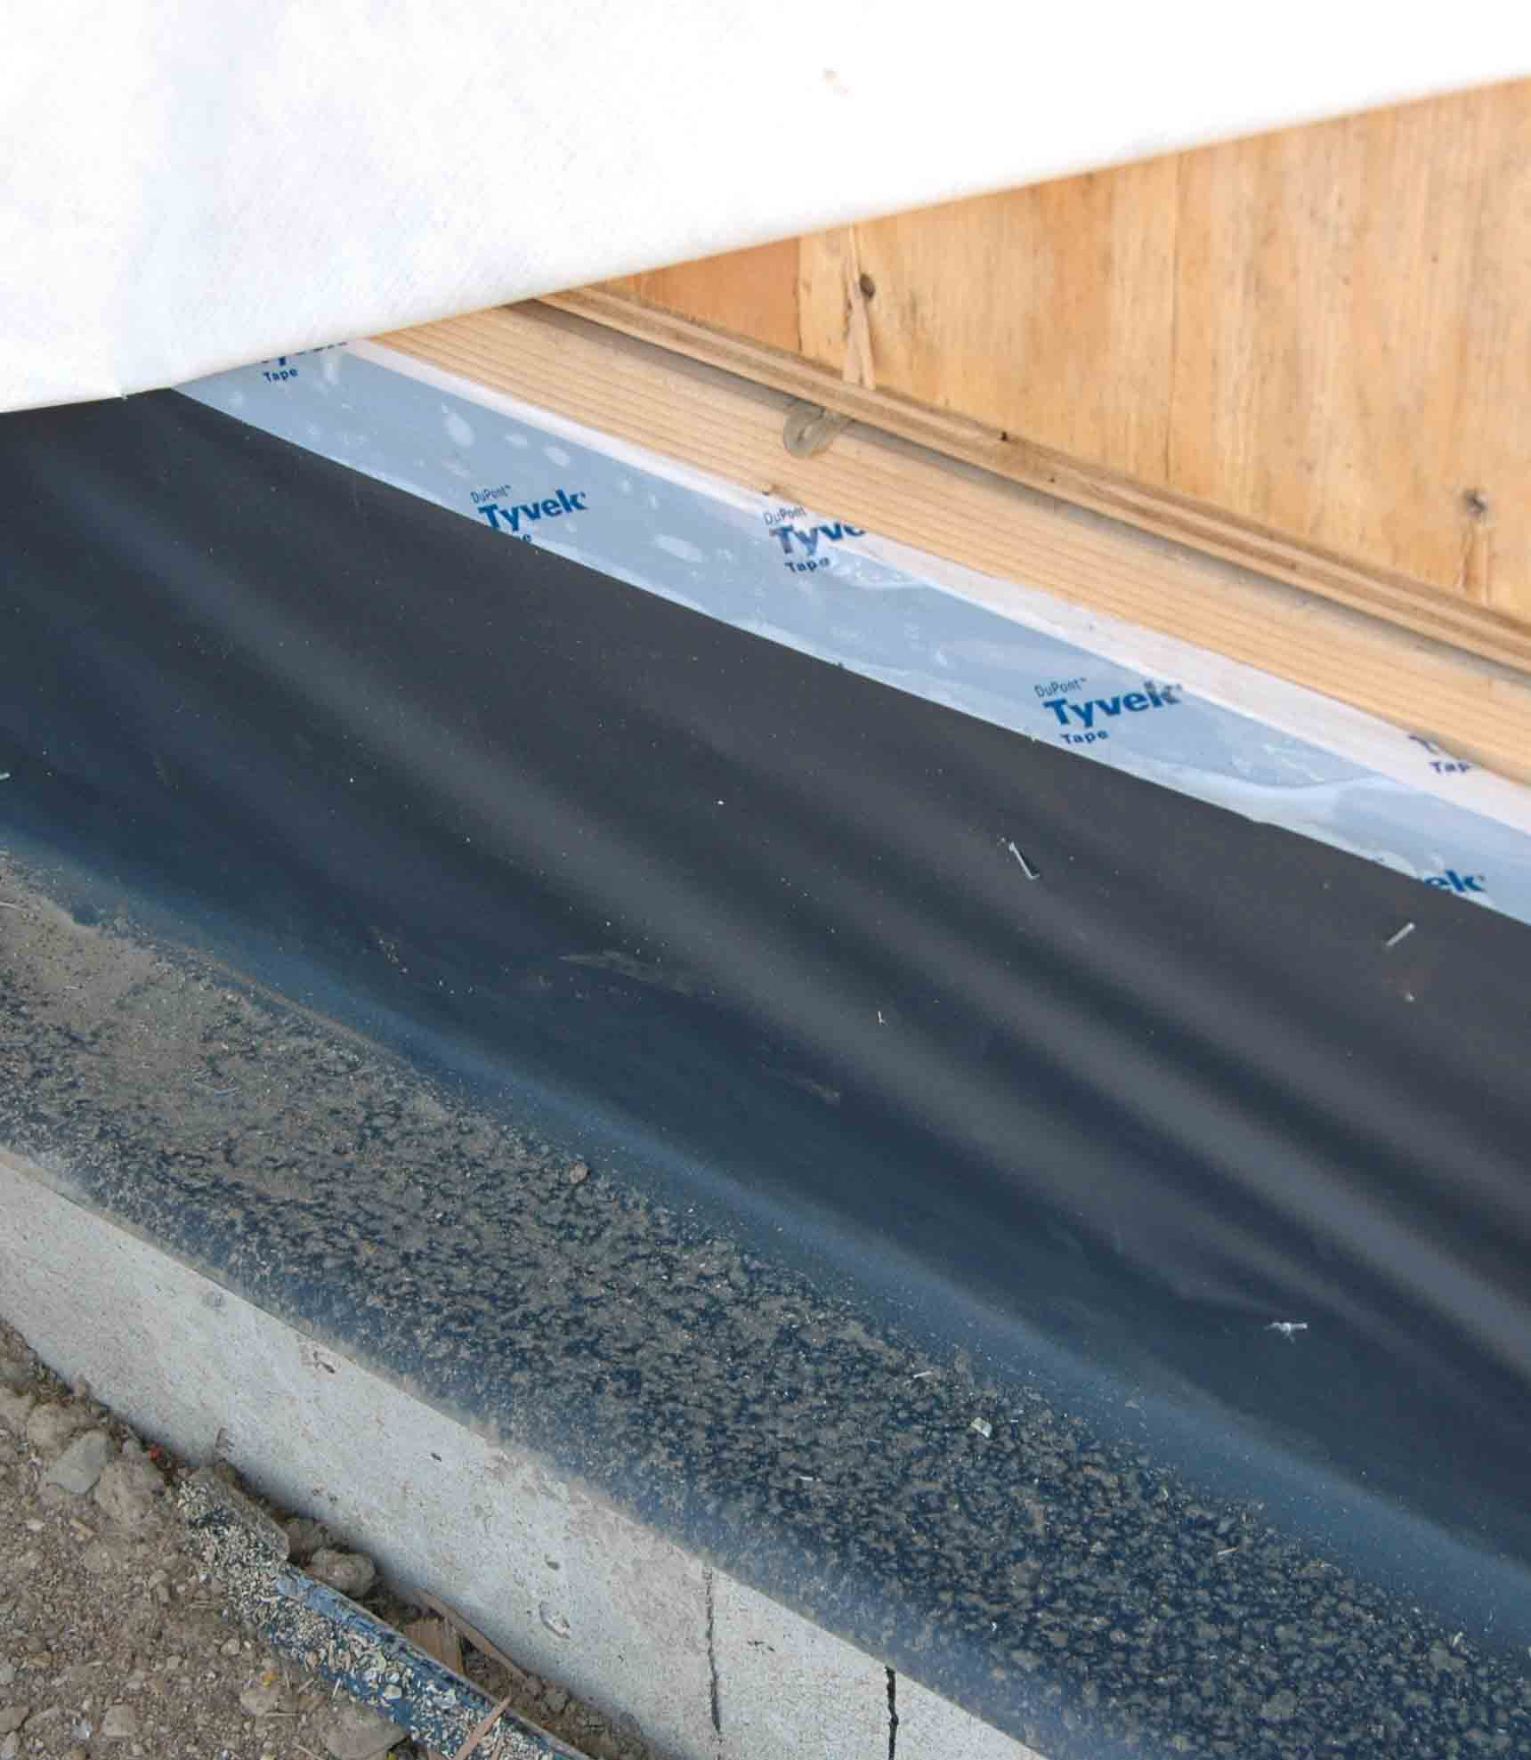
Photo Courtesy of Steve Easley & Associates, LLC
This is an example of a properly shingled through-wall flashing system. As you can see here, the black flashing starts at the top of the framing and extends down and out over the top of the brick ledge. When the house wrap (the white sheet folded out of the way at the top left of the photo) is folded down, water will be directed down the wall and out under the brick. The continuous drainage plane formed by the house wrap and flashing will protect the sheathing from moisture damage due to capillary action.
Notes:
This is an example of properly shingled through-wall flashing system. As you can see here, the black flashing is on top of the brick ledge. It goes up onto the framing, and is behind the weather-resistive barrier (white sheet folded out of the way near top of photo). When the WRB is folded down, it will protect the sheathing from moisture damage due to capillaryThis is an example of a properly shingled through-wall flashing system. As you can see here, the black flashing starts at the top of the framing and extends down and out over the top of the brick ledge. When the house wrap (the white sheet folded out of the way at the top left of the photo) is folded down, water will be directed down the wall and out under the brick. The continuous drainage plane formed by the house wrap and flashing will protect the sheathing from moisture damage due to capillary action.
action.

Slide 3
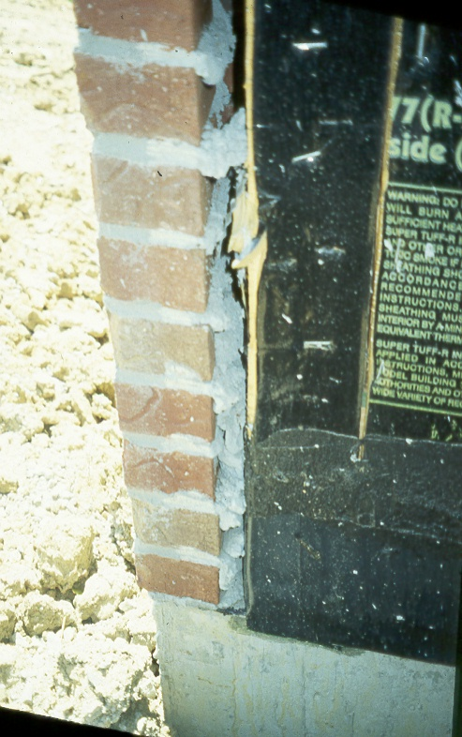
Photo Courtesy of Steve Easley & Associates, LLC
This picture clearly displays a problem that we call mortar bridging. This occurs when sloppy workmanship results in mortar oozing out behind the brick. This excess mortar can prevent water from freely draining out of the wall system. In fact, it even bridges the gap between the brick and the framing, allowing water to wick into wood materials, potentially causing damage to the sheathing and framing.
Notes:
This picture clearly displays a problem that we call mortar bridging. This occurs when sloppy workmanship results in mortar getting behind the brick. The problem is that this prevents water from freely draining out of the wall system. In fact, it even bridges the gap between the brick and the framing, allowing water to wick into wood materials, causing lots of problems.

Slide 4
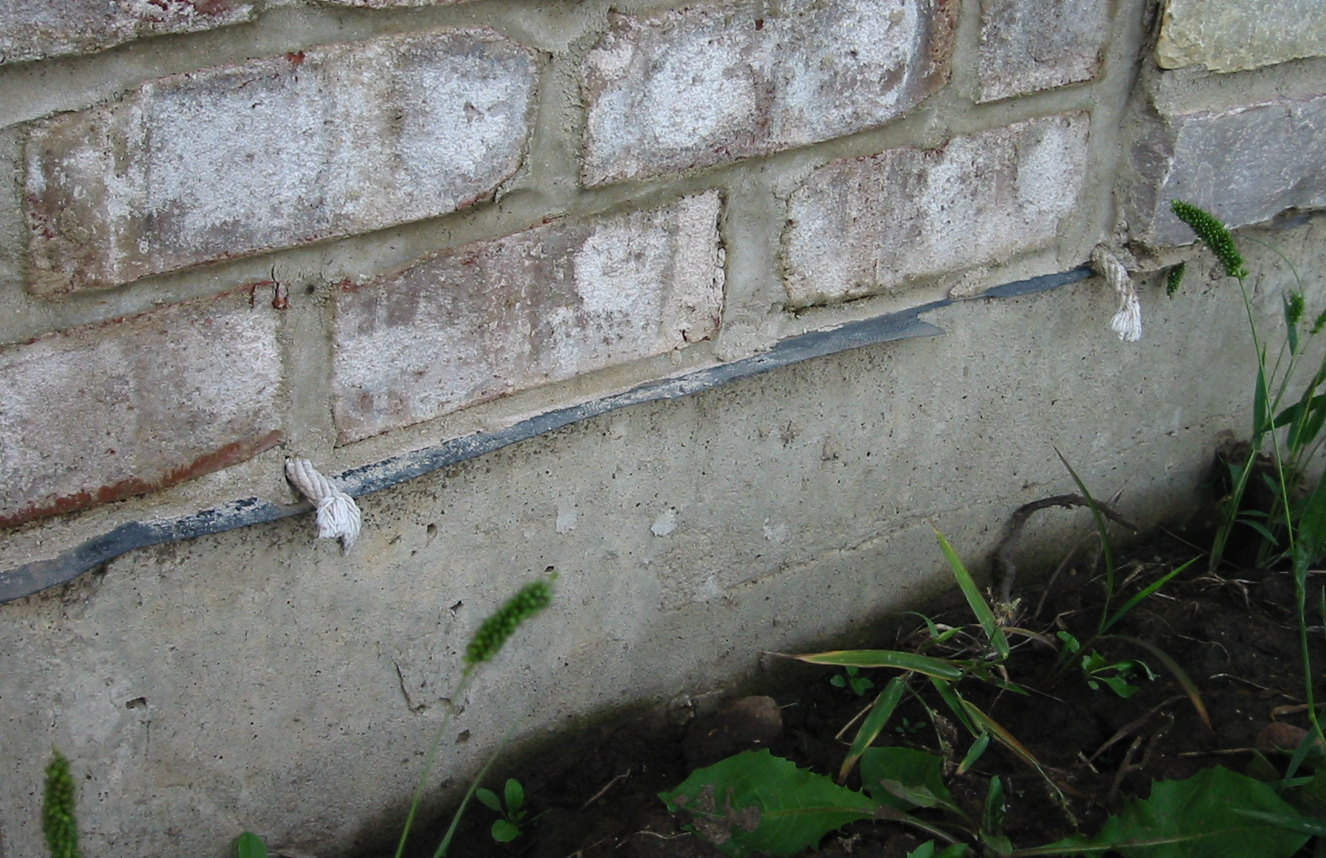
Photo Courtesy of Steve Easley & Associates, LLC
Building codes require that weep holes - holes placed at the base of a masonry wall - be spaced every 16 to 32 inches on center. Here you can see that these weep holes (where the holes are at) are correctly placed directly above the through-wall flashing. If water gets behind this brick, it can freely drain down and be wicked out through these ropes to daylight.
Notes:
Building codes require that weep holes - holes placed at the base of a masonry wall - be spaced every 16 to 32 inches on center. Here you can see that these weep holes (where the holes are at) are placed directly above the through-wall flashing. If water gets behind this brick, it can freely drain down and be wicked out through these ropes to daylight.

Slide 5
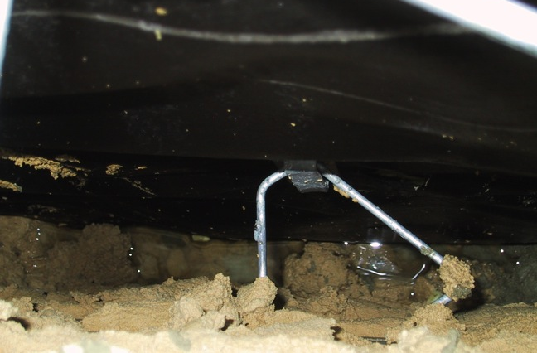
Photo Courtesy of Steve Easley & Associates, LLC
This picture is looking down between the brick veneer and the building paper on the exterior wall. (The metal piece is a brick tie.) This photo shows what happens when the weep holes get plugged. You can see here that there is water trapped at the base of this brick-veneer wall. It will eventually leak through the building paper and cause moisture problems.
Notes:
This picture shows what happens when the weep holes get plugged. You can see here that there is water trapped at the base of this brick-veneer wall. It will eventually leak through the building paper and cause moisture problems.

Slide 6
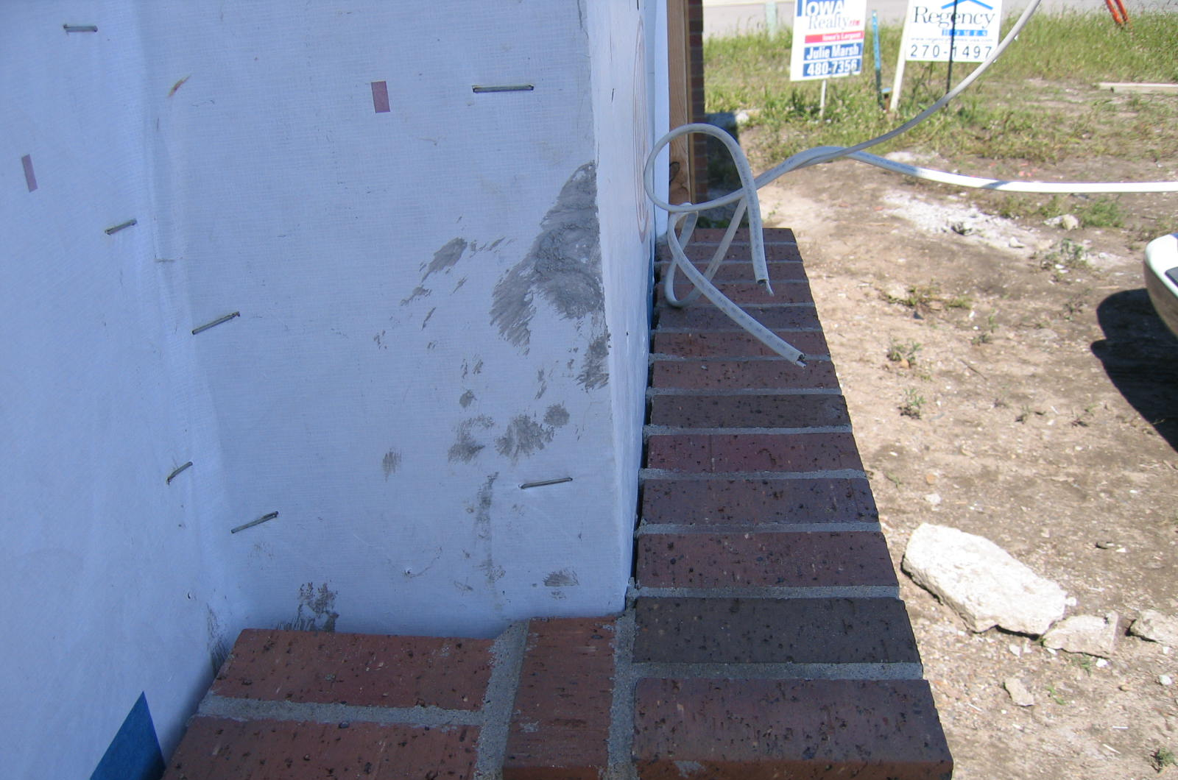
Photo Courtesy of Steve Easley & Associates, LLC
As you can see here, there is no air space between the brick and the weather-resistive barrier (WRB), which means there is no pathway for water to freely drain out. Water can easily get trapped behind here, leading to moisture damage. There should be at least a 1-inch airspace between the brick and the WRB.
Notes:
As you can see here there is no air space between the brick and the weather-resistive barrier (WRB), which means there is no pathway for water to freely drain out. Water can easily get trapped behind here, leading to moisture damage. There should be at least a 1-inch airspace between the brick and the WRB.

