Slide 1
Flashing and Drainage Planes behind Wood and Fiber-Cement Siding
Prepared for DOE’s Building America Program
Steve Easley & Associates, LLC
June 2023
www.steveeasley.com

Slide 2
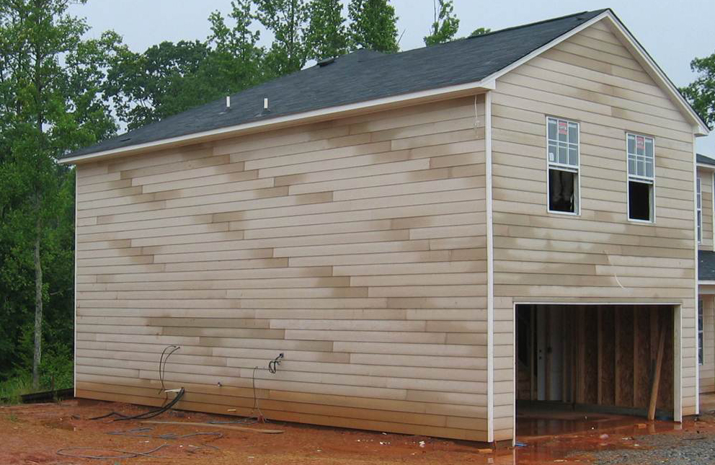
Photo Courtesy of Steve Easley & Associates, LLC
All cladding systems leak. It's not a matter of if, it's a matter of when. It's important to understand that proper moisture management dictates that when water gets through penetrations, we want this water to drain down the wall freely and exit the wall at the base of the siding. That's why the detailing and integration of flashings are so critical to building long-lasting, durable buildings.
Notes:
All cladding systems leak. It's not a matter of if, it's a matter of when. It's important to understand that proper moisture management dictates that when water gets through penetrations, we want this water to drain down the wall freely and exit the wall at the base of the siding. That's why the detailing and integration of flashings are so critical to building long-lasting, durable buildings.

Slide 3
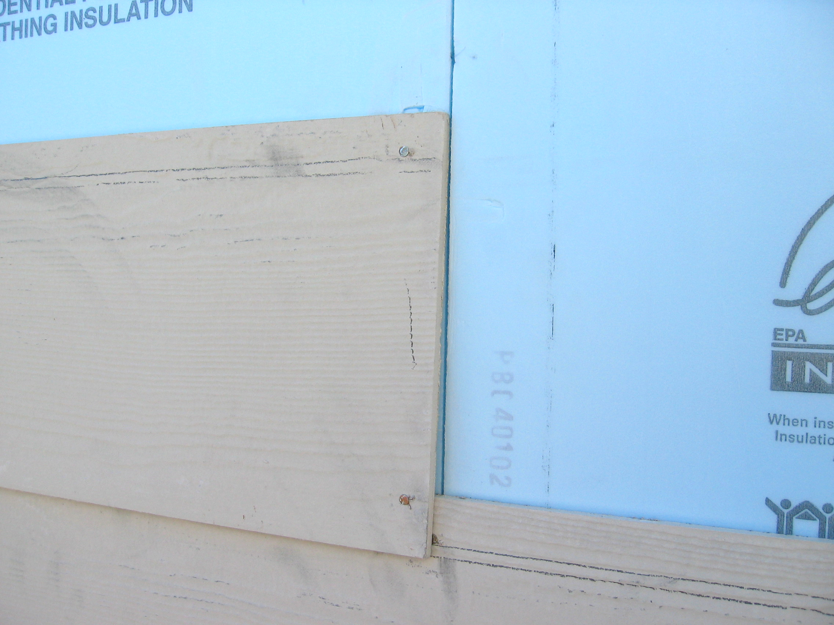
Photo Courtesy of Steve Easley & Associates, LLC
In this photograph we can see that this home has cement-board siding over foam board sheathing. Even though foam board sheathing is not affected by moisture, codes still require that we have a weather-resistive barrier (WRB) over the foam sheathing unless the product is approved for use as a WRB (when the joints are taped with an approved tape). As you can see here, the butt-joint of this siding lines up perfectly with the seam in the foam, which is not a recommended practice because in a wind-driven rain, it would be very easy for water to penetrate this seam and get in between the foam boards into the wall cavity where it can cause a lot of damage. It's critical to have a properly shingled WRB that directs the water downward, where it can exit freely.
Notes:
In this photograph we can see that this home has cement-board siding over foam board sheathing. Even though foam board sheathing is not affected by moisture, codes still require that we have a weather-resistive barrier (WRB) over the foam sheathing unless the product is approved for use as a WRB (when the joints are taped with an approved tape). As you can see here, the butt-joint of this siding lines up perfectly with the seam in the foam, which is not a recommended practice because in a wind-driven rain, it would be very easy for water to penetrate this seam and get in between the foam boards into the wall cavity where it can cause a lot of damage. It's critical to have a properly shingled WRB that directs the water downward, where it can exit freely.

Slide 4
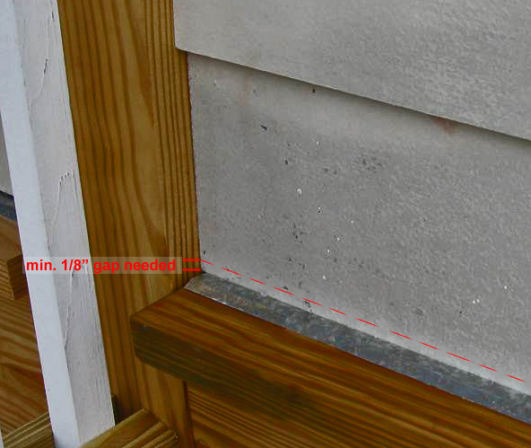
Photo Courtesy of Steve Easley & Associates, LLC
This photograph shows an example of improper drainage at the base of the wall in conjunction with cement-board siding. The moisture build-up in the siding shows that the wall is not getting free drainage. One of the problems here is there is not enough space between the bottom of the siding and that through-wall flashing. There should be at least a 1/8- inch gap to prevent capillary action. And it's important that the flashing be properly integrated behind the weather-resistive barrier for proper shingling of water away from the house.
Notes:
This photograph shows an example of improper drainage at the base of the wall in conjunction with cement-board siding. The moisture build-up in the siding shows that the wall is not getting free drainage. One of the problems here is there is not enough space between the bottom of the siding and that through-wall flashing. There should be at least a 1/8- inch gap to prevent capillary action. And it's important that the flashing be properly integrated behind the weather-resistive barrier for proper shingling of water away from the house.

Slide 5
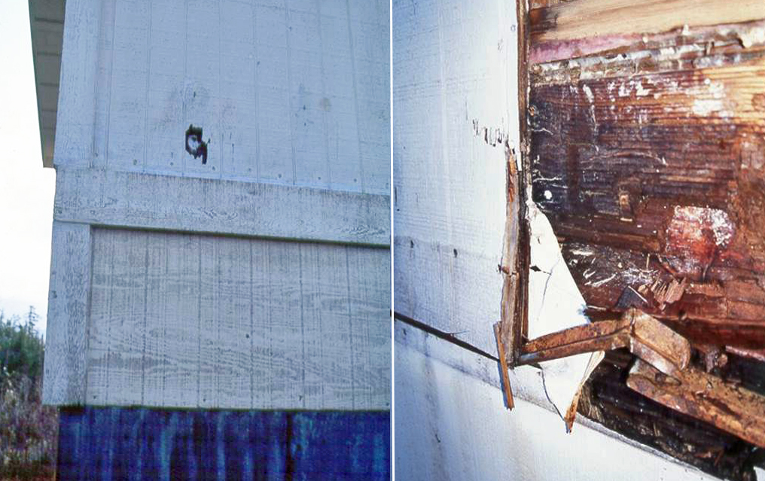
Photo Courtesy of Steve Easley & Associates, LLC
In the photograph on the left, we can see that we have T-111 siding. These T-111 siding panels may not be long enough to side the entire structure without a seam. So here for example, we have two pieces of T-111 siding covered by a trim board. In the photo on the right, we can see there is a substantial amount of damage due to water leaks at the seam where these two pieces of T-111 siding meet. You can also see that there was a thin piece of metal Z-flashing, but it was not adequately sized, nor properly integrated with flashing and the weather-resistive barrier to provide free drainage to the base of the wall.
Notes:
In the photograph on the left, we can see that we have T-111 siding. These T-111 siding panels may not be long enough to side the entire structure without a seam. So here for example, we have two pieces of T-111 siding covered by a trim board. In the photo on the right, we can see there is a substantial amount of damage due to water leaks at the seam where these two pieces of T-111 siding meet. You can also see that there was a thin piece of metal Z-flashing, but it was not adequately sized, nor properly integrated with flashing and the weather-resistive barrier to provide free drainage to the base of the wall.

Slide 6
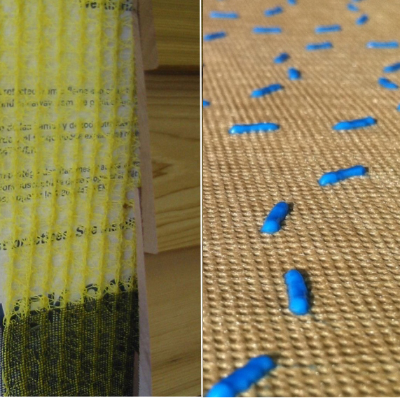
Photo Courtesy of Steve Easley & Associates, LLC
It's fairly typical for wood or cement-board siding to be installed tightly up against the building wrap, and this can restrict drainage. So manufacturers have created rain-screen materials and drainage wraps. The photo on the left shows a rain-screen product. This is a plastic matrix that is about 1/4-inch thick that is installed over the board sheathing and weather-resistant barrier to provide an air space which facilitates drainage and helps prevent capillary action, so water can drain down the wall system and exit at the base of the siding. The product on the right is a drainage wrap material. Drain wraps have a wrinkled or textured surface; in this case, plastic beads are deposited on the surface to create a space for drainage. It doesn't take much of an air space to create better drainage.
Notes:
It's fairly typical for wood or cement-board siding to be installed tightly up against the building wrap, and this can restrict drainage. So manufacturers have created rain-screen materials and drainage wraps. The photo on the left shows a rain-screen product. This is a plastic matrix that is about 1/4-inch thick that is installed over the board sheathing and weather-resistant barrier to provide an air space which facilitates drainage and helps prevent capillary action, so water can drain down the wall system and exit at the base of the siding. The product on the right is a drainage wrap material. Drain wraps have a wrinkled or textured surface; in this case, plastic beads are deposited on the surface to create a space for drainage. It doesn't take much of an air space to create better drainage.

