Slide 1
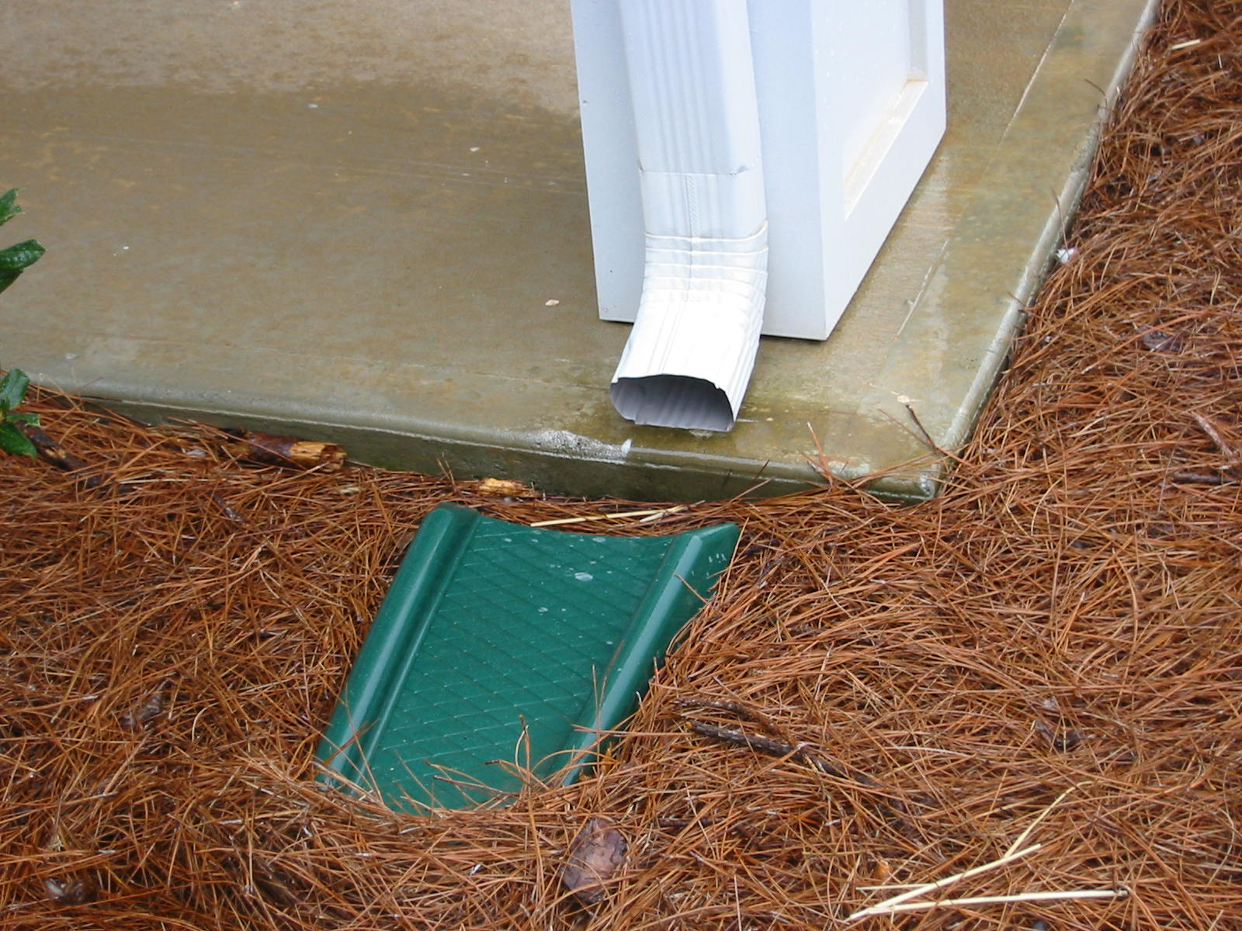
Notes:
Splash blocks alone are not sufficient. By themselves, splash blocks will not direct water far enough from the building foundation. In addition, they are prone to being displaced. To be effective at all, the end of the downspout shown above must lap onto splash block. (Photo courtesy of Steve Easley & Associates.)

Slide 2
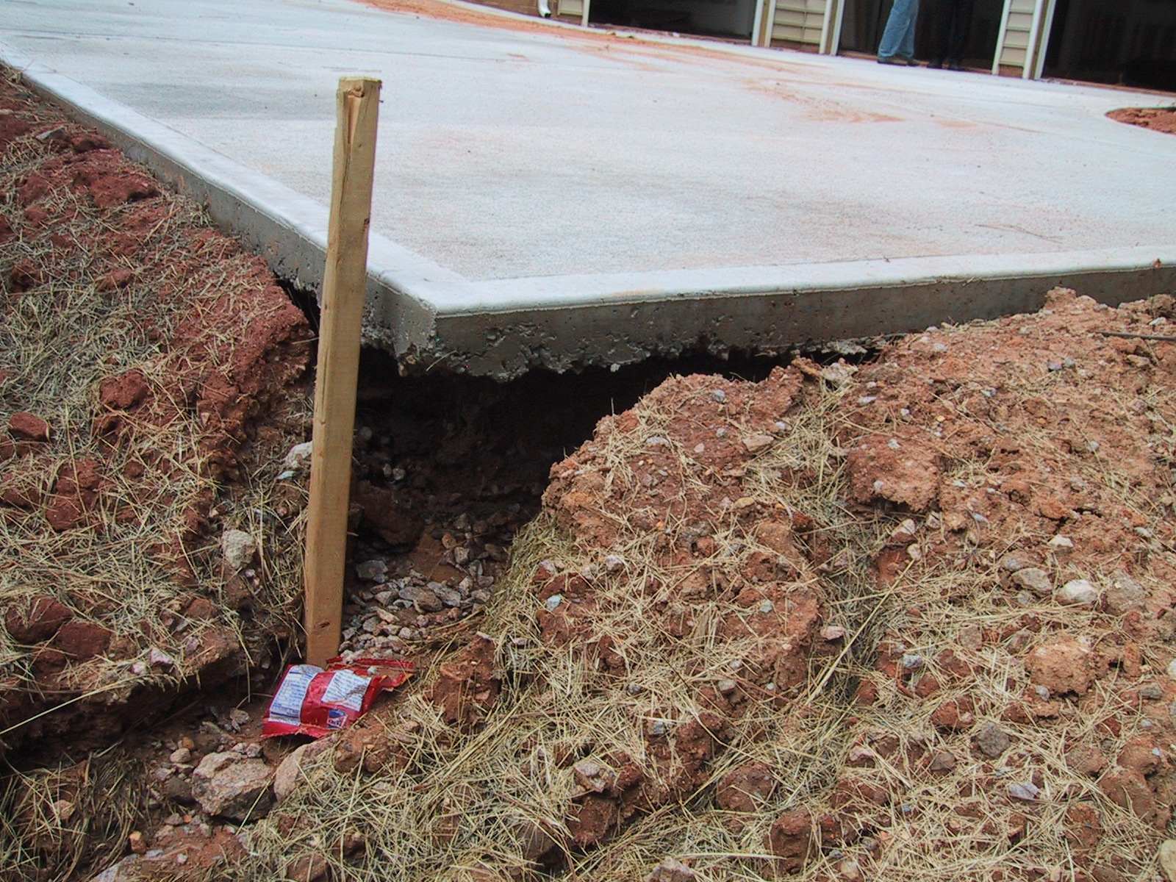
Notes:
Erosion. Over time, the downspout placement shown in the previous photo is likely to erode the soil beneath the slab in a manner similar to the erosion shown here.
(Photo courtesy of Steve Easley & Associates.)

Slide 3
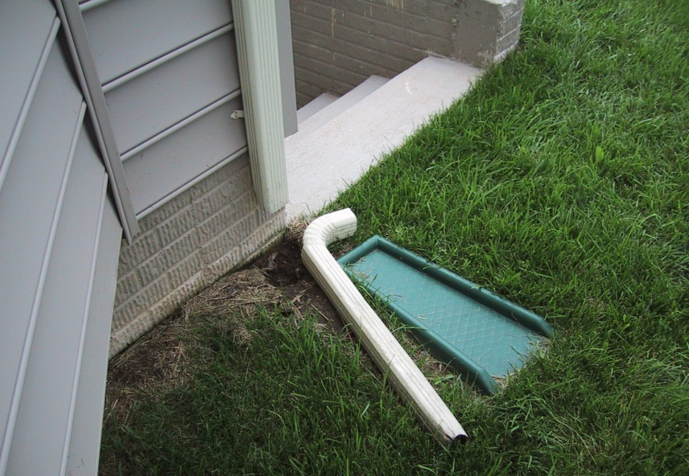
Notes:
All the right pieces in all the wrong places. Together, the downspout extension with a splash block would be sufficient to direct water far enough away from the foundation … provided, of course they are actually connected to the downspout. This example underscores why a subsurface pipe is the best solution. Above-grade extensions are prone to getting dislodged or moved for yard work. If they don't get hooked up again, the result is a concentrated flow of water directed right into the foundation.
(Photo courtesy of Steve Easley & Associates.)

Slide 4
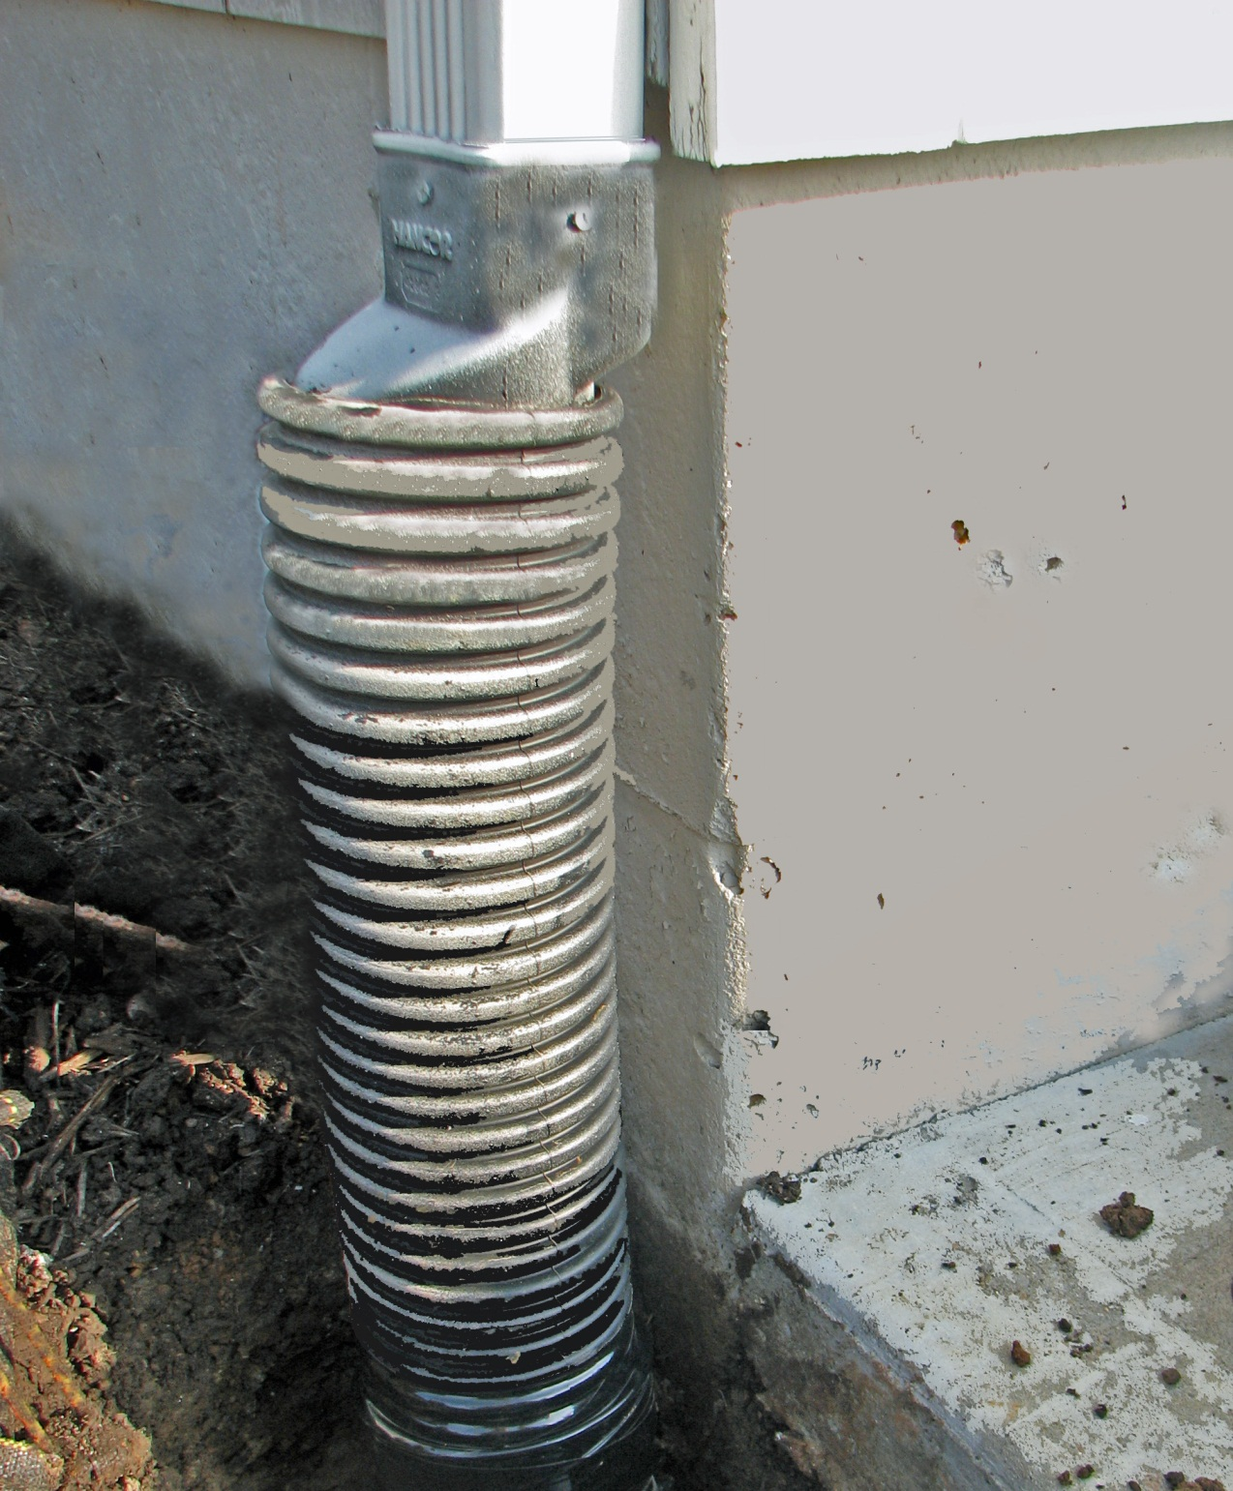
Notes:
Best practice for downspouts calls for burying the extension below grade. This places the horizontal section out of the way. To connect to the downspout, an adapter to a flexible corrugated line, such as the one shown here, can be used. The end of the extension should run horizontally at least 5 feet from the building foundation, or connect to a catchment system, storm sewer or rainwater harvesting system.
(Photo courtesy of Steve Easley & Associates.)

