Slide 1
Do’s and Don’ts for Stucco Walls
Prepared for DOE’s Building America Program
Steve Easley & Associates, LLC
June 2023
www.steveeasley.com

Slide 2
Photo Courtesy of Steve Easley & Associates, LLC
Stucco is a popular cladding material because it can be durable and long lasting, and it doesn't require a lot of maintenance. However, it is important to follow a few building science principles relating to water management to ensure that the stucco does not trap water or let water into the wall assembly.
Notes:
Stucco is a popular cladding material because it can be durable and long lasting, and it doesn't require a lot of maintenance. However, it is important to follow a few building science principles relating to water management to ensure that the stucco does not trap water or let water into the wall assembly.

Slide 3
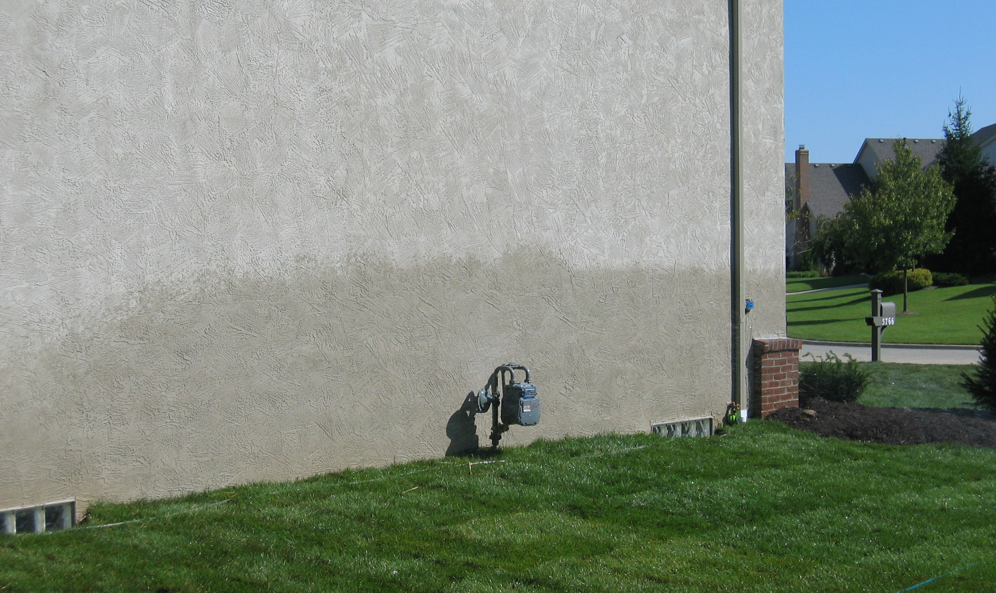
Photo Courtesy of Steve Easley & Associates, LLC
A couple things are wrong in this picture: The stucco runs all the way to grade, and there is no weep screed. The bottom of the stucco must have a perforated weep screed to allow water to drain out of the wall system, and this screed should be at least 8 inches above grade. If the stucco runs all the way to grade, moisture from capillary action can wick up into the stucco, and transfer to wood framing. Also the irrigation system is incorrectly aimed and is soaking the walls. In addition, the crawlspace vents are located below rather than above grade.
Courtesy of Steve Easley & Associates LLC.
Notes:
A couple things are wrong in this picture: The stucco runs all the way to grade, and there is no weep screed. The bottom of the stucco must have a weep screed to allow water to drain out of the wall system, and this screed should be at least 8 inches above grade. If the stucco runs all the way to grade, moisture from capillary action can wick up into the stucco, and transfer to wood framing.

Slide 4
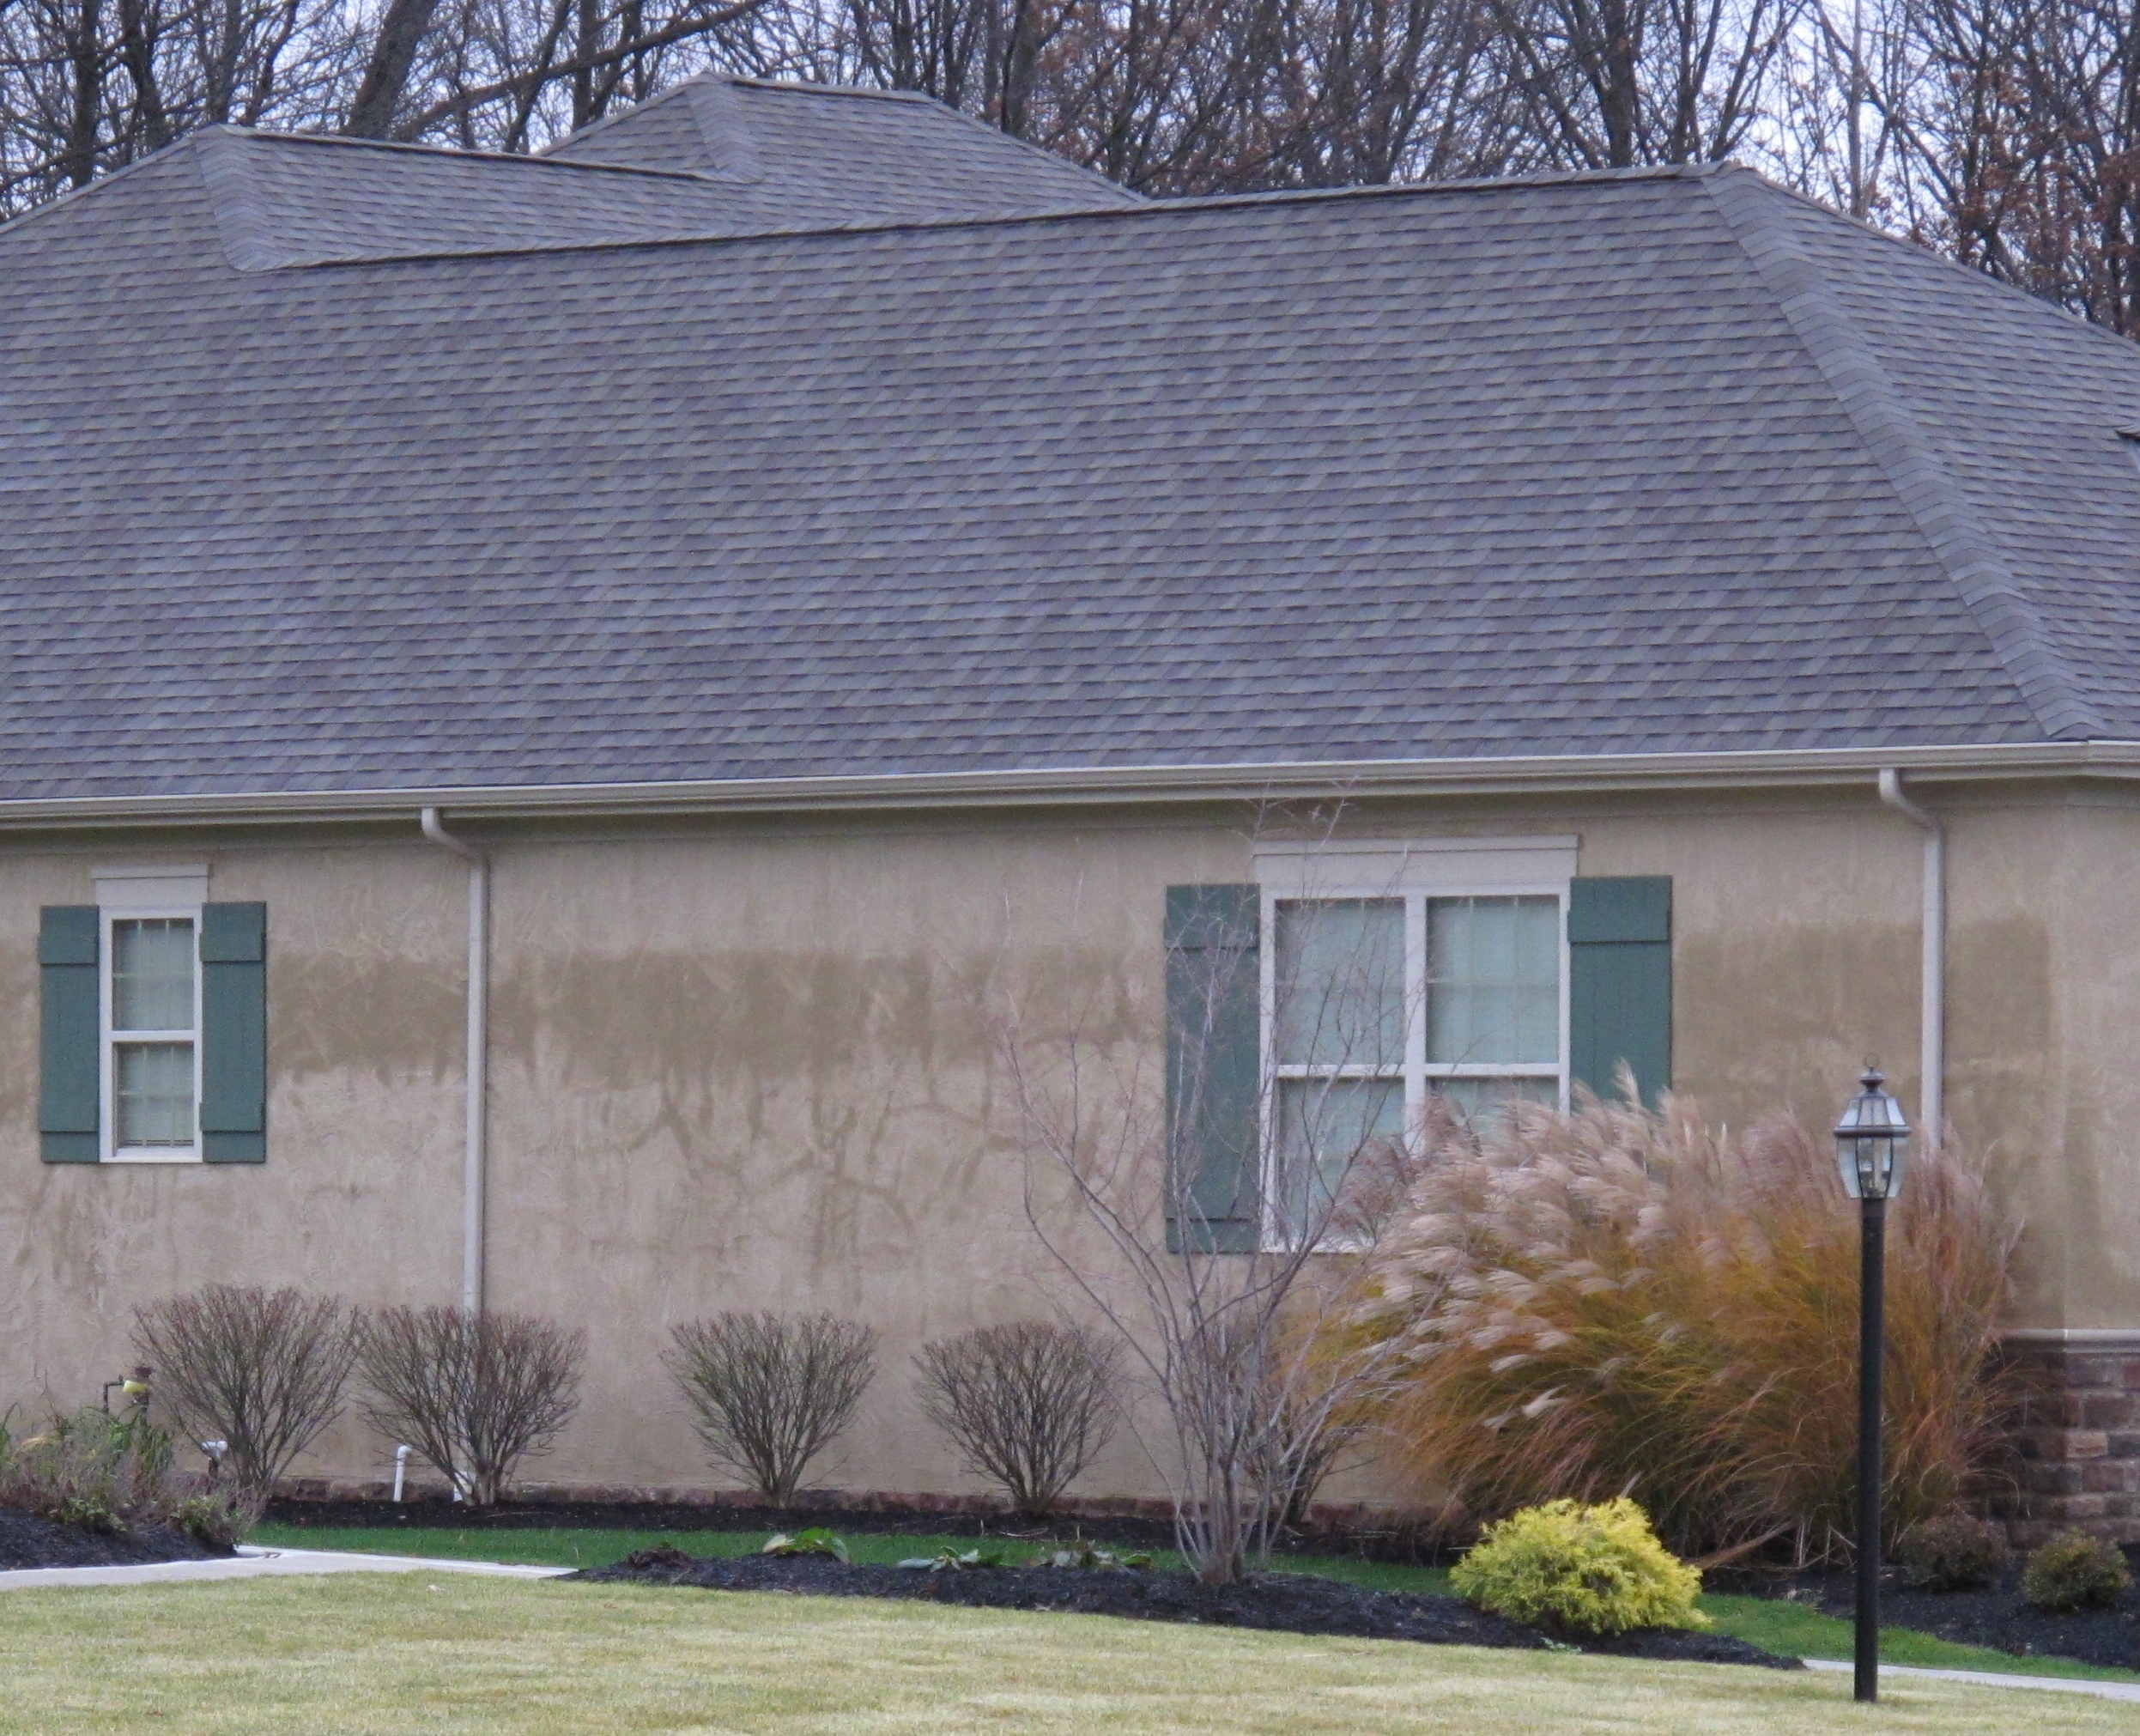
Photo Courtesy of Steve Easley & Associates, LLC
This picture illustrates how important it is to have a good water management system behind stucco. You can see that rainwater has been absorbed into the cracks. Now, all stucco cracks; that's fairly common. But that's why it is so important to have a good water management system. Most building codes require two layers of building wrap or draining house wrap or building paper, and that house wrap must overlap a weep screed flashing that is installed at the base of the wall.
Courtesy of Steve Easley & Associates LLC.
Notes:
This picture illustrates how important it is to have a good water management system behind stucco. You can see that rain water has been absorbed into the cracks. Now all stucco cracks; that's fairly common. But that's why it is so important to have a good water management system. Most building codes requires two layers of building wrap, or building paper, and that must be integrated with a weep screed flashing at the base of the wall.

Slide 5
Photo Courtesy of Steve Easley & Associates, LLC
This is an example of a draining house wrap or “corrugated” house wrap. When selecting drainage wrap, select one that has a drainage efficacy of over 90% for use behind stucco.

Slide 6
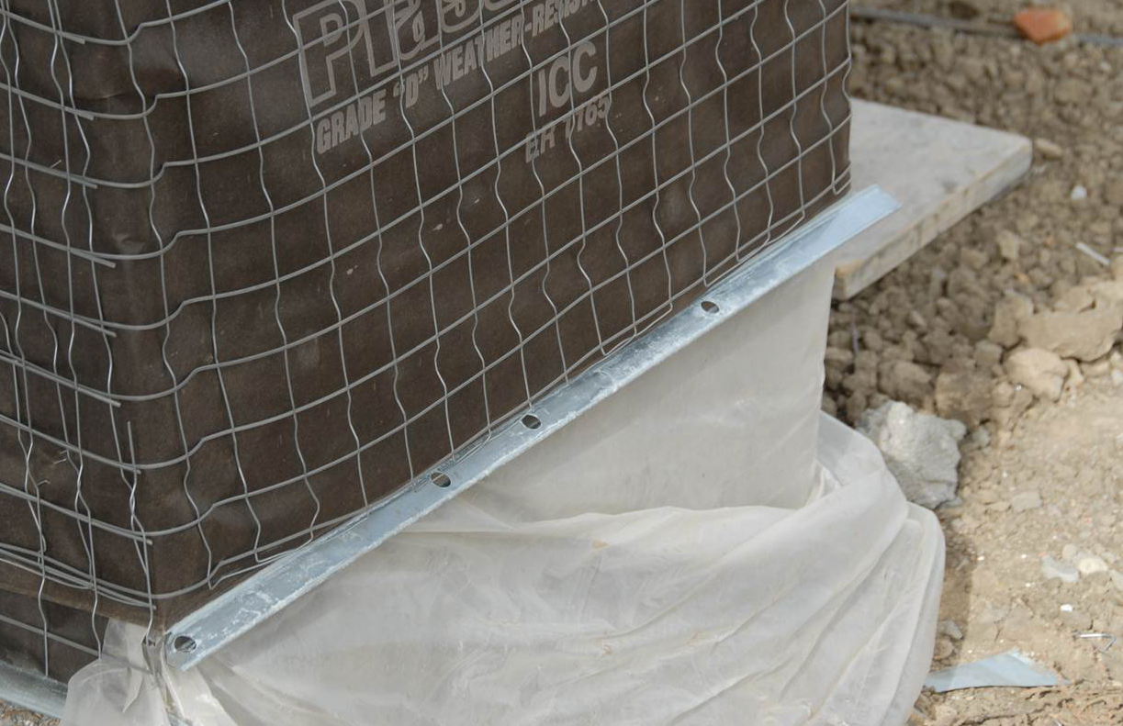
Photo Courtesy of Steve Easley & Associates, LLC
This is a picture of a properly integrated weather resistive barrier (WRB) at the base of the wall. You can see the stucco screed is perforated - has holes in it - so when the stucco is troweled over the top, it has the capacity to allow moisture to drain through it. What's important to note here is that the back flange on the screed goes up behind the paper, so any water that does get behind the stucco will hit the paper, run down, hit the stucco screed and drain down through the perforations.
Courtesy of Steve Easley & Associates LLC.
Notes:
This is a picture of properly integrated flashing at the base of the wall. You can see the stucco screed is perforated - has holes in it - so when the stucco is troweled over the top, it has the capacity to allow moisture to drain through it. What's important to note here is that the back flange on the screed goes up behind the paper, so any water that does get behind the stucco will hit the paper, run down, hit the stucco screed and drain down through the perforations.

Slide 7
Photo Courtesy of Steve Easley & Associates, LLC
In this picture, the stucco screed is reverse shingled at the base of the wall. You can see that the metal flashing is actually in front of the black paper. To be properly shingled, the black paper should overlap the metal stucco screed. That way, when water gets behind the stucco, it runs down the paper onto the metal flashing and is diverted to the exterior.
Courtesy of Steve Easley & Associates LLC.
Notes:
In this picture, the stucco screed is reverse shingled at the base of the wall. You can see that the metal flashing is actually in front of the black paper. To be properly shingled, the black paper should overlap the metal stucco screed. That way, when water gets behind the stucco, it runs down the paper onto the metal flashing and is diverted to the exterior.

Slide 8
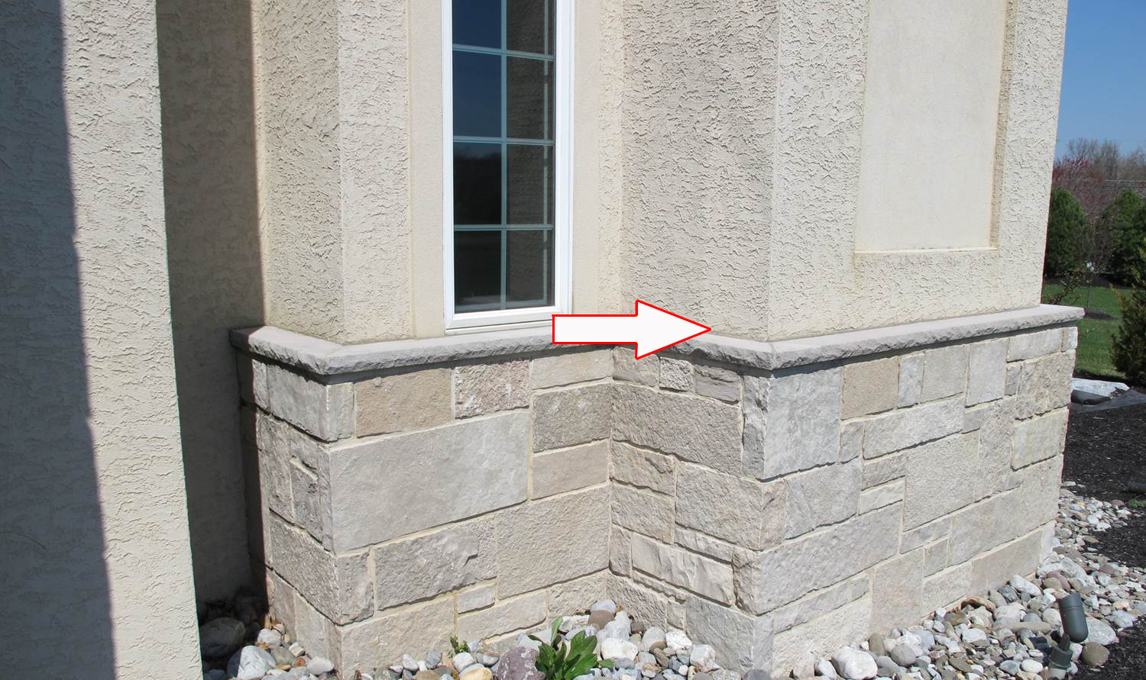
Photo Courtesy of Steve Easley & Associates, LLC
It's a fairly common building practice to integrate multiple types of cladding on a single wall. For example, here we have stone at the base, with a cap, and then we have stucco at the top. The problem in this photograph is where the stucco interfaces with the capstone: This wall assembly is missing the code-required through-wall flashing. Any water that gets behind the stucco can run down the wall and get trapped by the stone. Note there are no weep holes in the stone, so there's no way for the water to get out. It's always best practice to put through-wall flashing where you have this transition between one cladding system and another.
Courtesy of Steve Easley & Associates LLC.
Notes:
It's a fairly common building practice to integrate multiple types of cladding on a single wall. For example, here we have stone at the base, with a cap, and then we have stucco at the top. The problem in this photograph is where the stucco interfaces with the capstone: There's no through-wall flashing. Any water that gets behind the stucco, can run down the wall and get trapped by the stone. Note there are no weep holes in the stone, so there's no way for the water to get out. It's always best practice to put through-wall flashing where you have this transition between one cladding system and another.

Slide 9
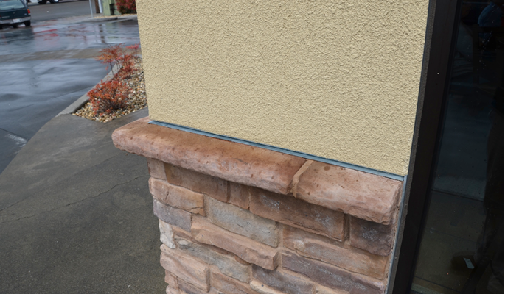
Photo Courtesy of Steve Easley & Associates, LLC
This is an example of properly installed through-wall flashing above the stone-stucco interface.
Courtesy of Steve Easley & Associates LLC.
Notes:
It's a fairly common building practice to integrate multiple types of cladding on a single wall. For example, here we have stone at the base, with a cap, and then we have stucco at the top. The problem in this photograph is where the stucco interfaces with the capstone: There's no through-wall flashing. Any water that gets behind the stucco, can run down the wall and get trapped by the stone. Note there are no weep holes in the stone, so there's no way for the water to get out. It's always best practice to put through-wall flashing where you have this transition between one cladding system and another.

Slide 10
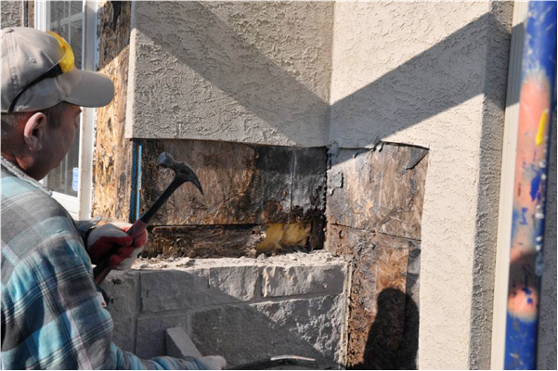
Photo Courtesy of Steve Easley & Associates, LLC
This is an example of moisture damage behind stucco due to the use of only one layer of building paper, the lack of through-wall flashing above the stone veneer, and lack of air space and weep holes at the base of the stucco of the wall.
Courtesy of Steve Easley & Associates LLC.
Notes:
It's a fairly common building practice to integrate multiple types of cladding on a single wall. For example, here we have stone at the base, with a cap, and then we have stucco at the top. The problem in this photograph is where the stucco interfaces with the capstone: There's no through-wall flashing. Any water that gets behind the stucco, can run down the wall and get trapped by the stone. Note there are no weep holes in the stone, so there's no way for the water to get out. It's always best practice to put through-wall flashing where you have this transition between one cladding system and another.

